Slide 1
Optimal control of trajectory of reusable launcher in OpenMDAO/dymos
Students:
Alberto Fossà
Giuliana Elena Miceli
Tutors:
Laurent Beauregard
Joseph Morlier
Stéphanie Lizy-Destrez
March 27th 2020
Notes:
Alberto

Slide 2
Outline
Context
Optimal control problem
Achievements of Semester 2
2D Descent Trajectory
2D Low Lunar Orbit to Highly Elliptical Orbit Transfer
Surrogate Models
LaTOM Software Package
Conclusions & Future achievements
Notes:
Alberto

Slide 3
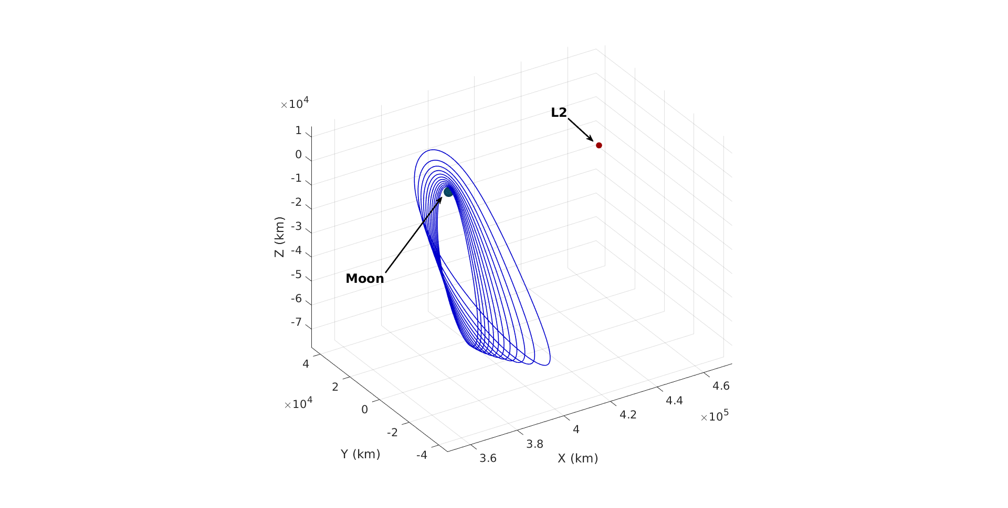
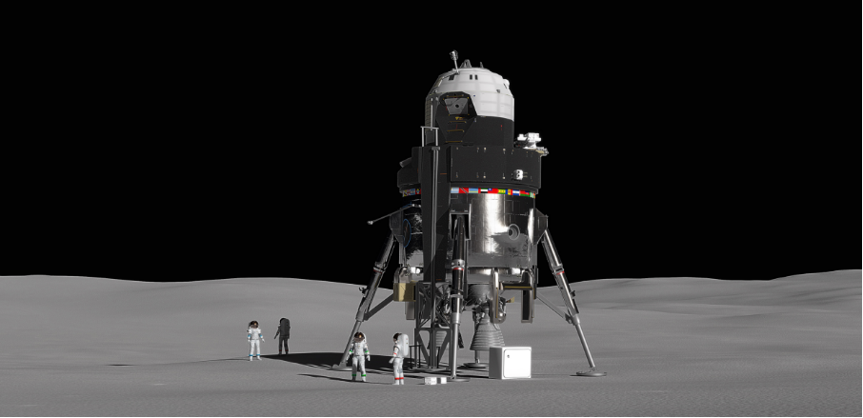
Context
Moon and Mars Exploration
In-situ resources exploitation
Lunar Orbital Platform Gateway
L2 NRHO
L2 southern NRHO family
Lunar Lander prototype. Credits: Lockheed Martin
Notes:
Alberto

Slide 4
Optimal control problem: implementation
Formulation
Optimal Control Theory
EOMs
Constraints
Transcription
Gauss-Lobatto¹
Radau-Pseudospectral²
OpenMDAO³
NLP Solution
OpenMDAO³
SNOPT⁸
PyOptSparse⁵
IPOPT^{6,7}
dymos⁴
¹Herman et al. “Direct Optimization Using Collocation Based on High-Order Gauss-Lobatto Quadrature Rules.” Journal of Guidance, Control, and Dynamics (1996)
²Garg et al. “Direct Trajectory Optimization and Costate Estimation of General Optimal Control Problems Using a Radau Pseudospectral Method.” AIAA Guidance, Navigation, and Control Conference (2009)
³Gray et al. “OpenMDAO: An Open-Source Framework for Multidisciplinary Design, Analysis, and Optimization.” Structural and Multidisciplinary Optimization (2019)
⁴Hendricks et al. “Simultaneous Propulsion System and Trajectory Optimization.” 18th AIAA/ISSMO Multidisciplinary Analysis and Optimization Conference (2017)
⁵Perez et al. “PyOpt: A Python-Based Object-Oriented Framework for Nonlinear Constrained Optimization.” Structural and Multidisciplinary Optimization (2012)
⁶Wächter et al. “On the Implementation of an Interior-Point Filter Line-Search Algorithm for Large-Scale Nonlinear Programming.” Mathematical Programming (2006)
⁷HSL, A Collection of Fortran Codes for Large Scale Scientific Computation. http://www.hsl.rl.ac.uk/.
⁸Gill, P., et al. “SNOPT: An SQP Algorithm for Large-Scale Constrained Optimization.” SIAM Review (2005)
Notes:
Alberto

Slide 5
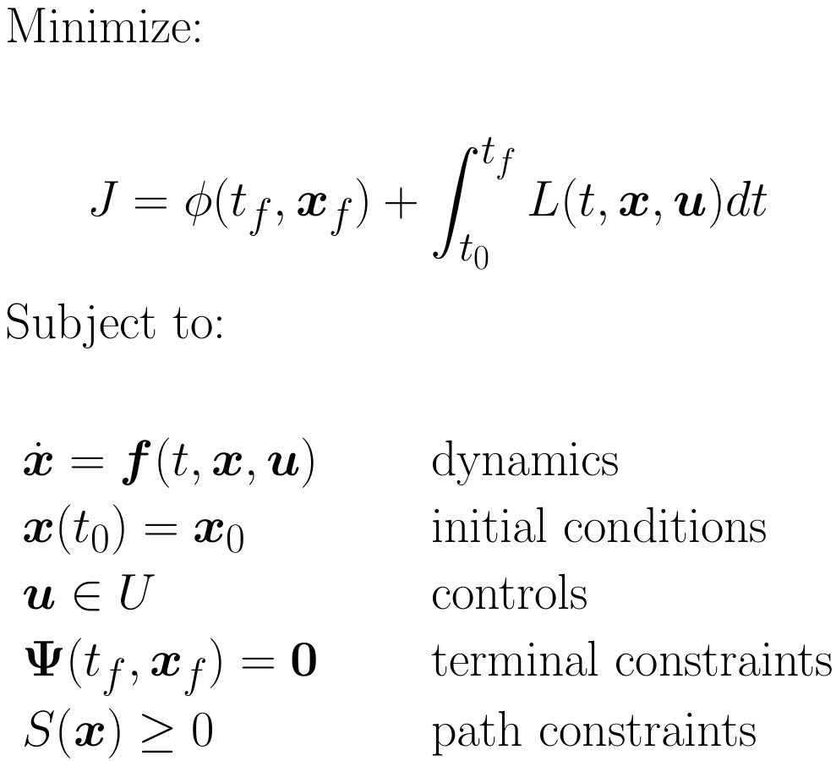
Optimal control problem: formulation
Mathematical formulation of a continuous-time optimal control problem
Notes:
Alberto

Slide 6
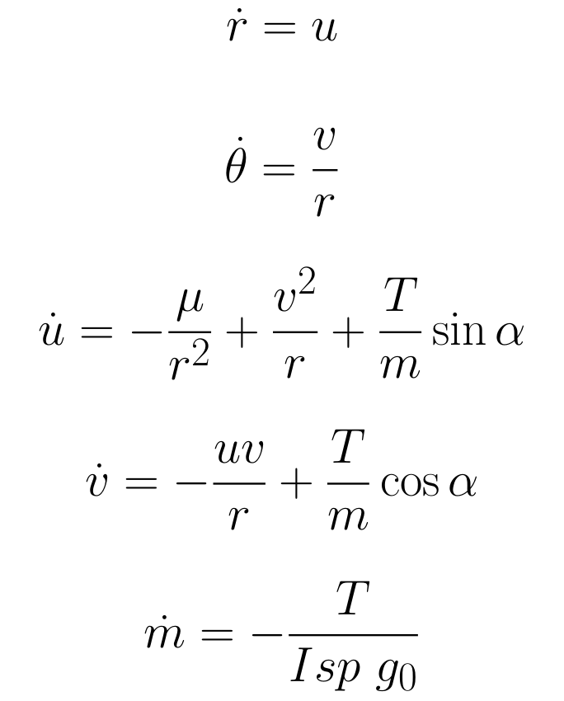
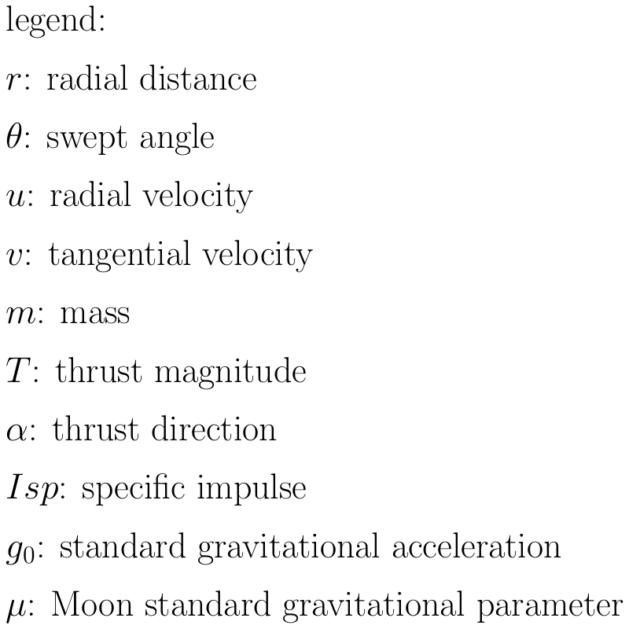
Equations of Motion
T
V
v
u
r
θ
Notes:
Alberto

Slide 7
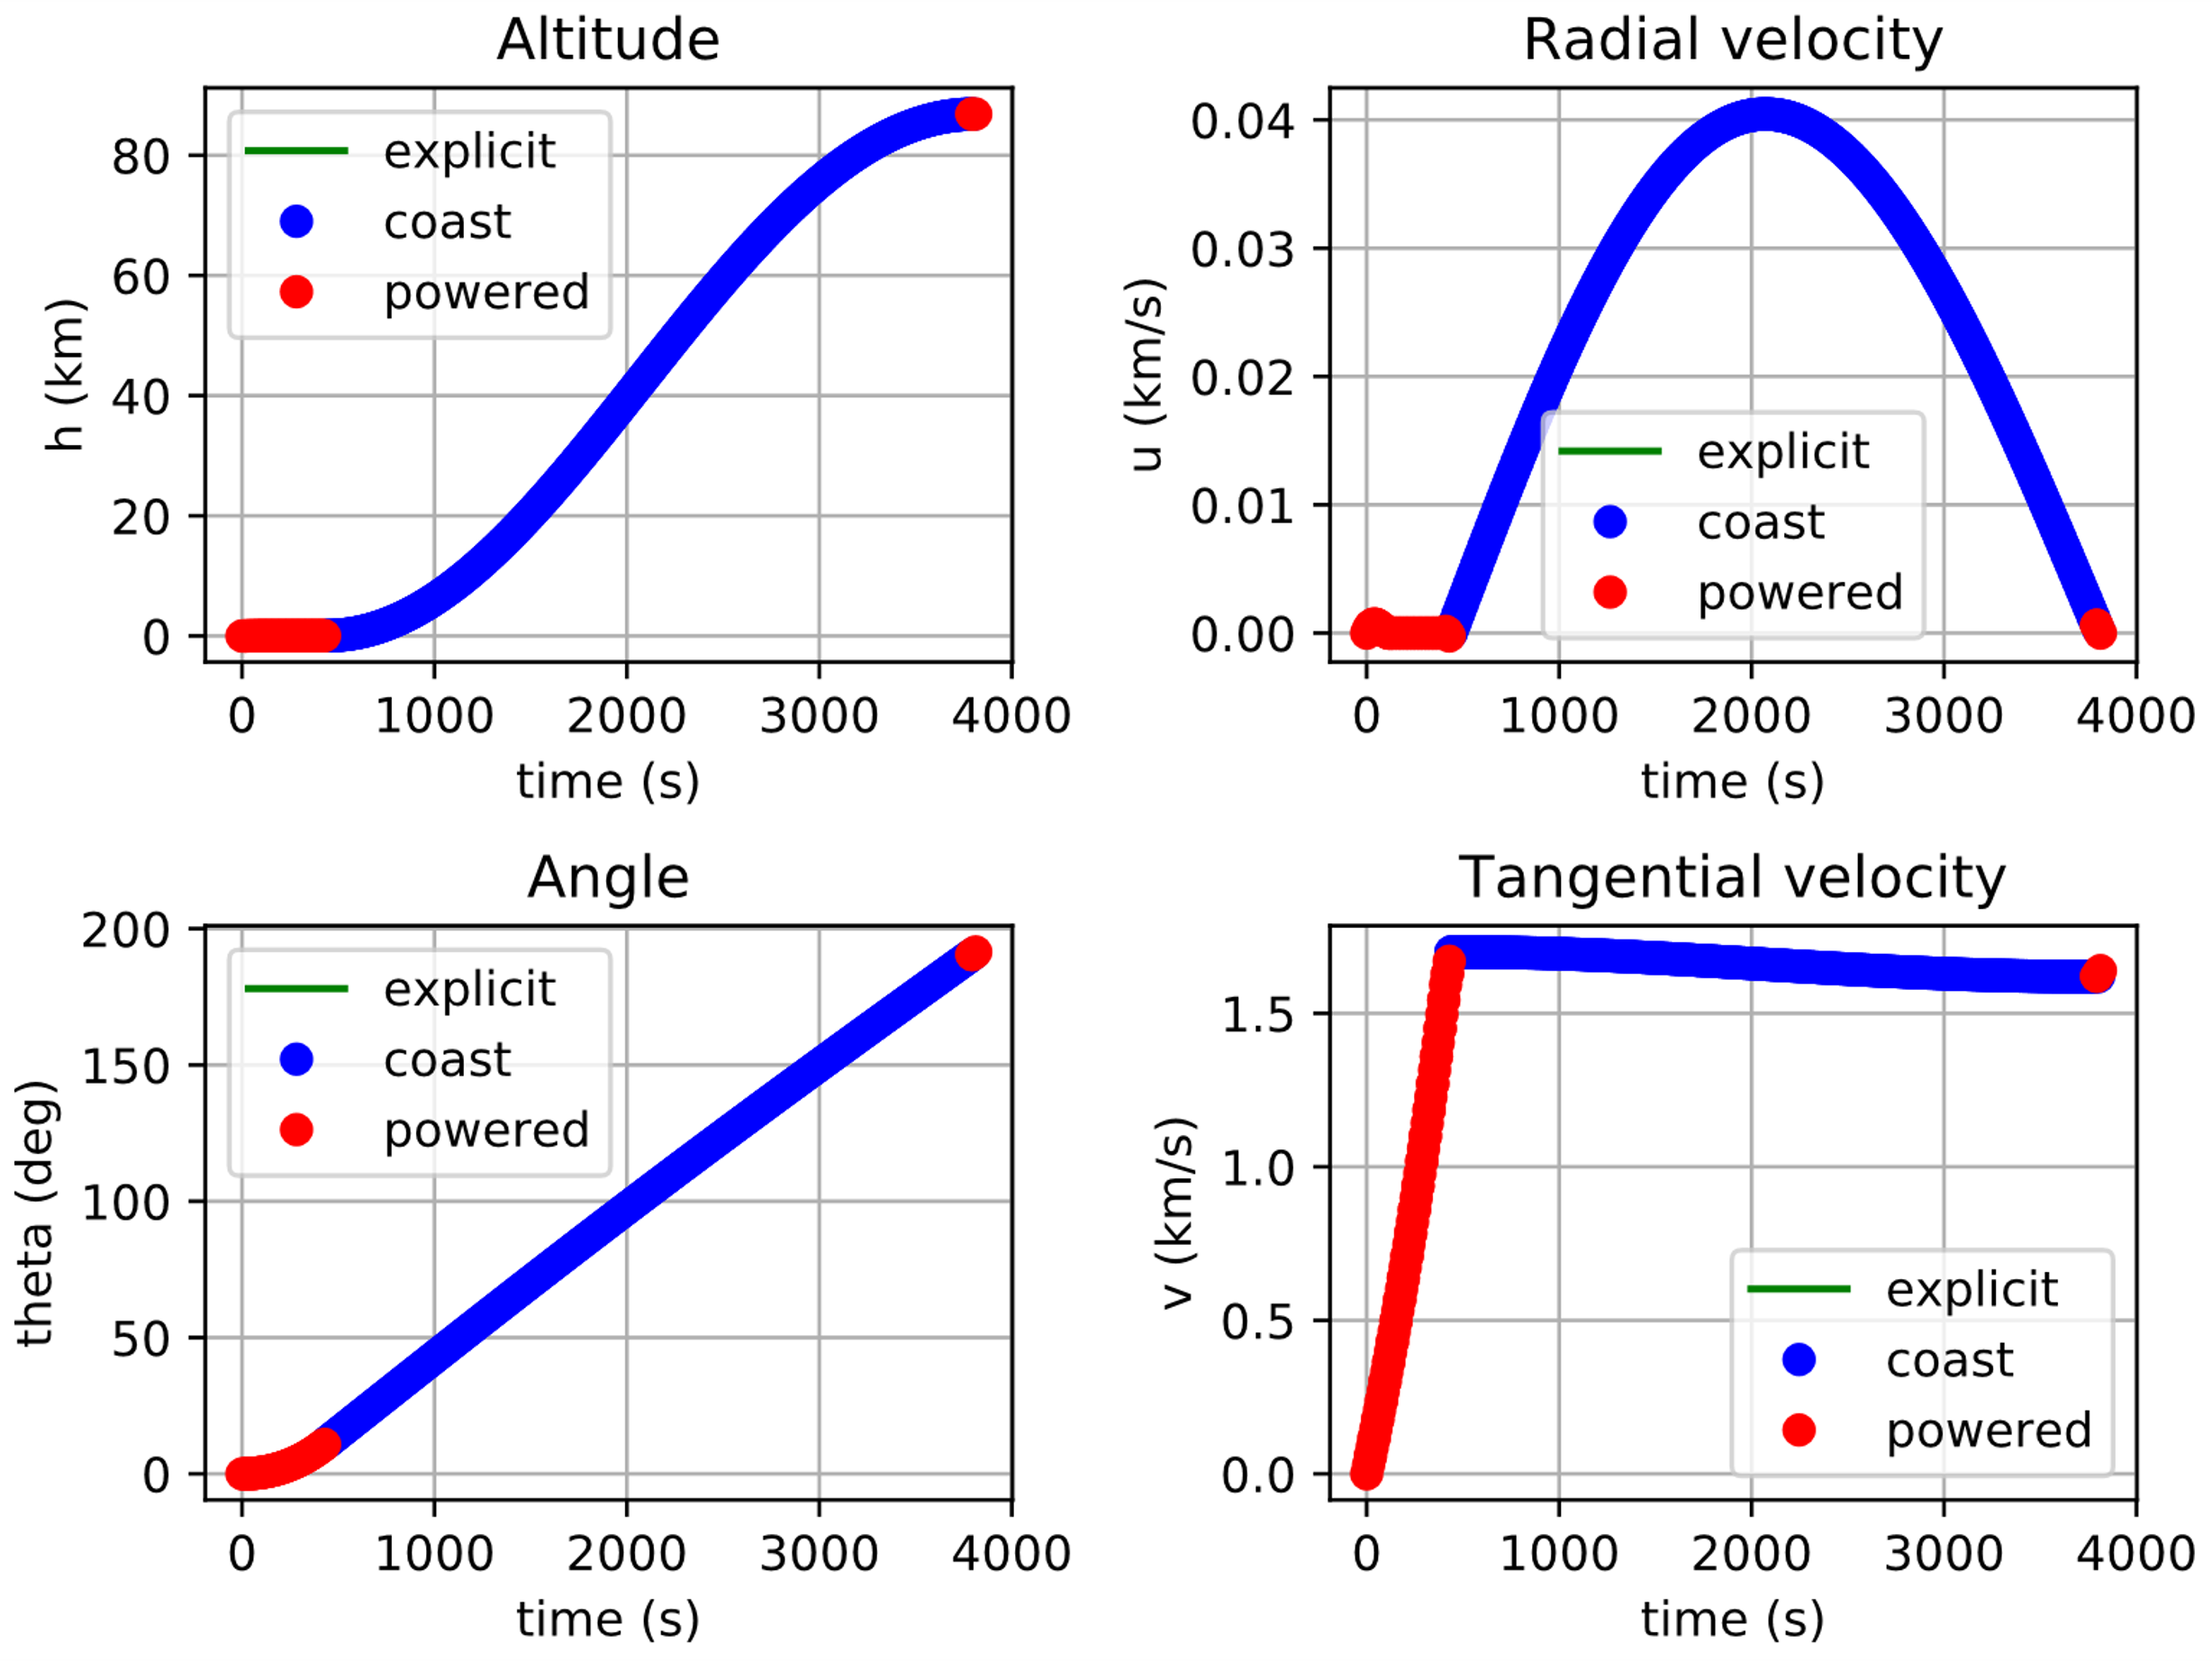
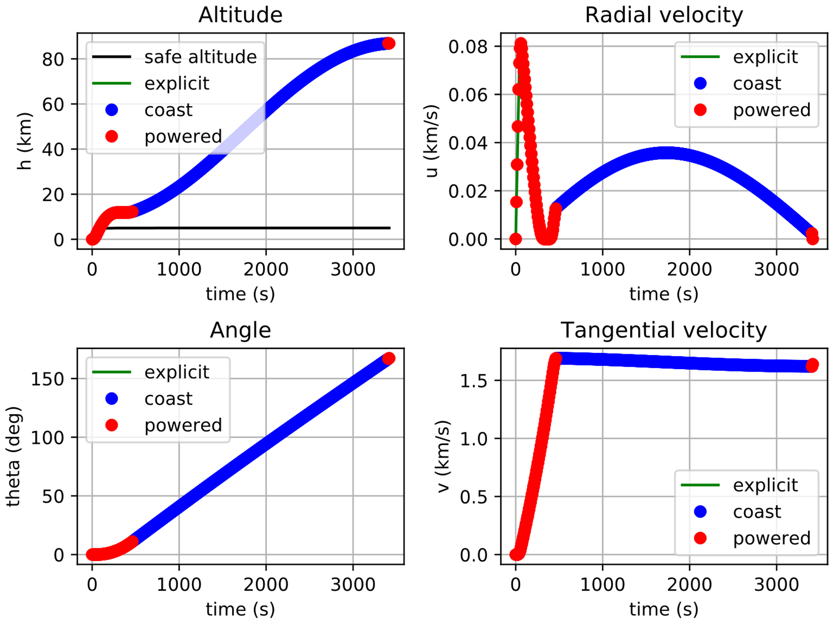
Achievements of Semester 2
Ascent with variable thrust
Ascent with variable thrust and minimum safe altitude
Parameters
h | 86.87 km
Isp | 450 s
twr | 2.1
Ascent Trajectory | Time of Flight | Propellant consumption
Constant Thrust | 476.13 s | 36.80%
Variable Thrust | 3697.56 s | 33.64%
Variable Thrust, Minimum safe altitude | 3367.77 s | 35.50%
Notes:
Giuliana

Slide 8
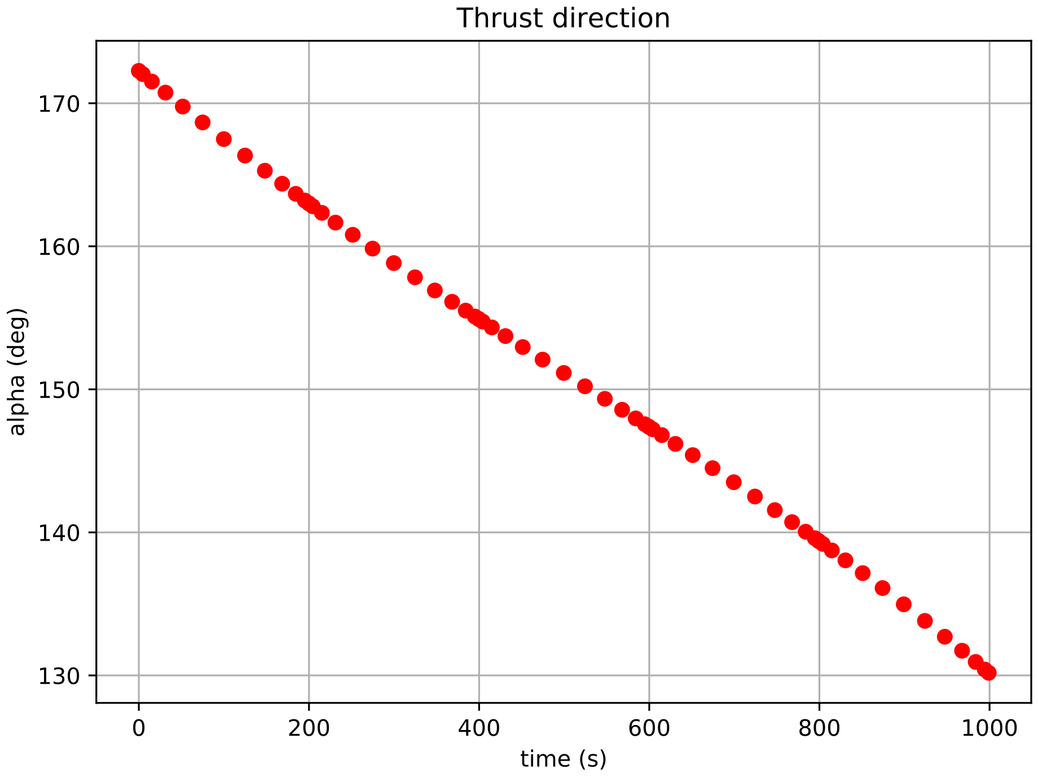
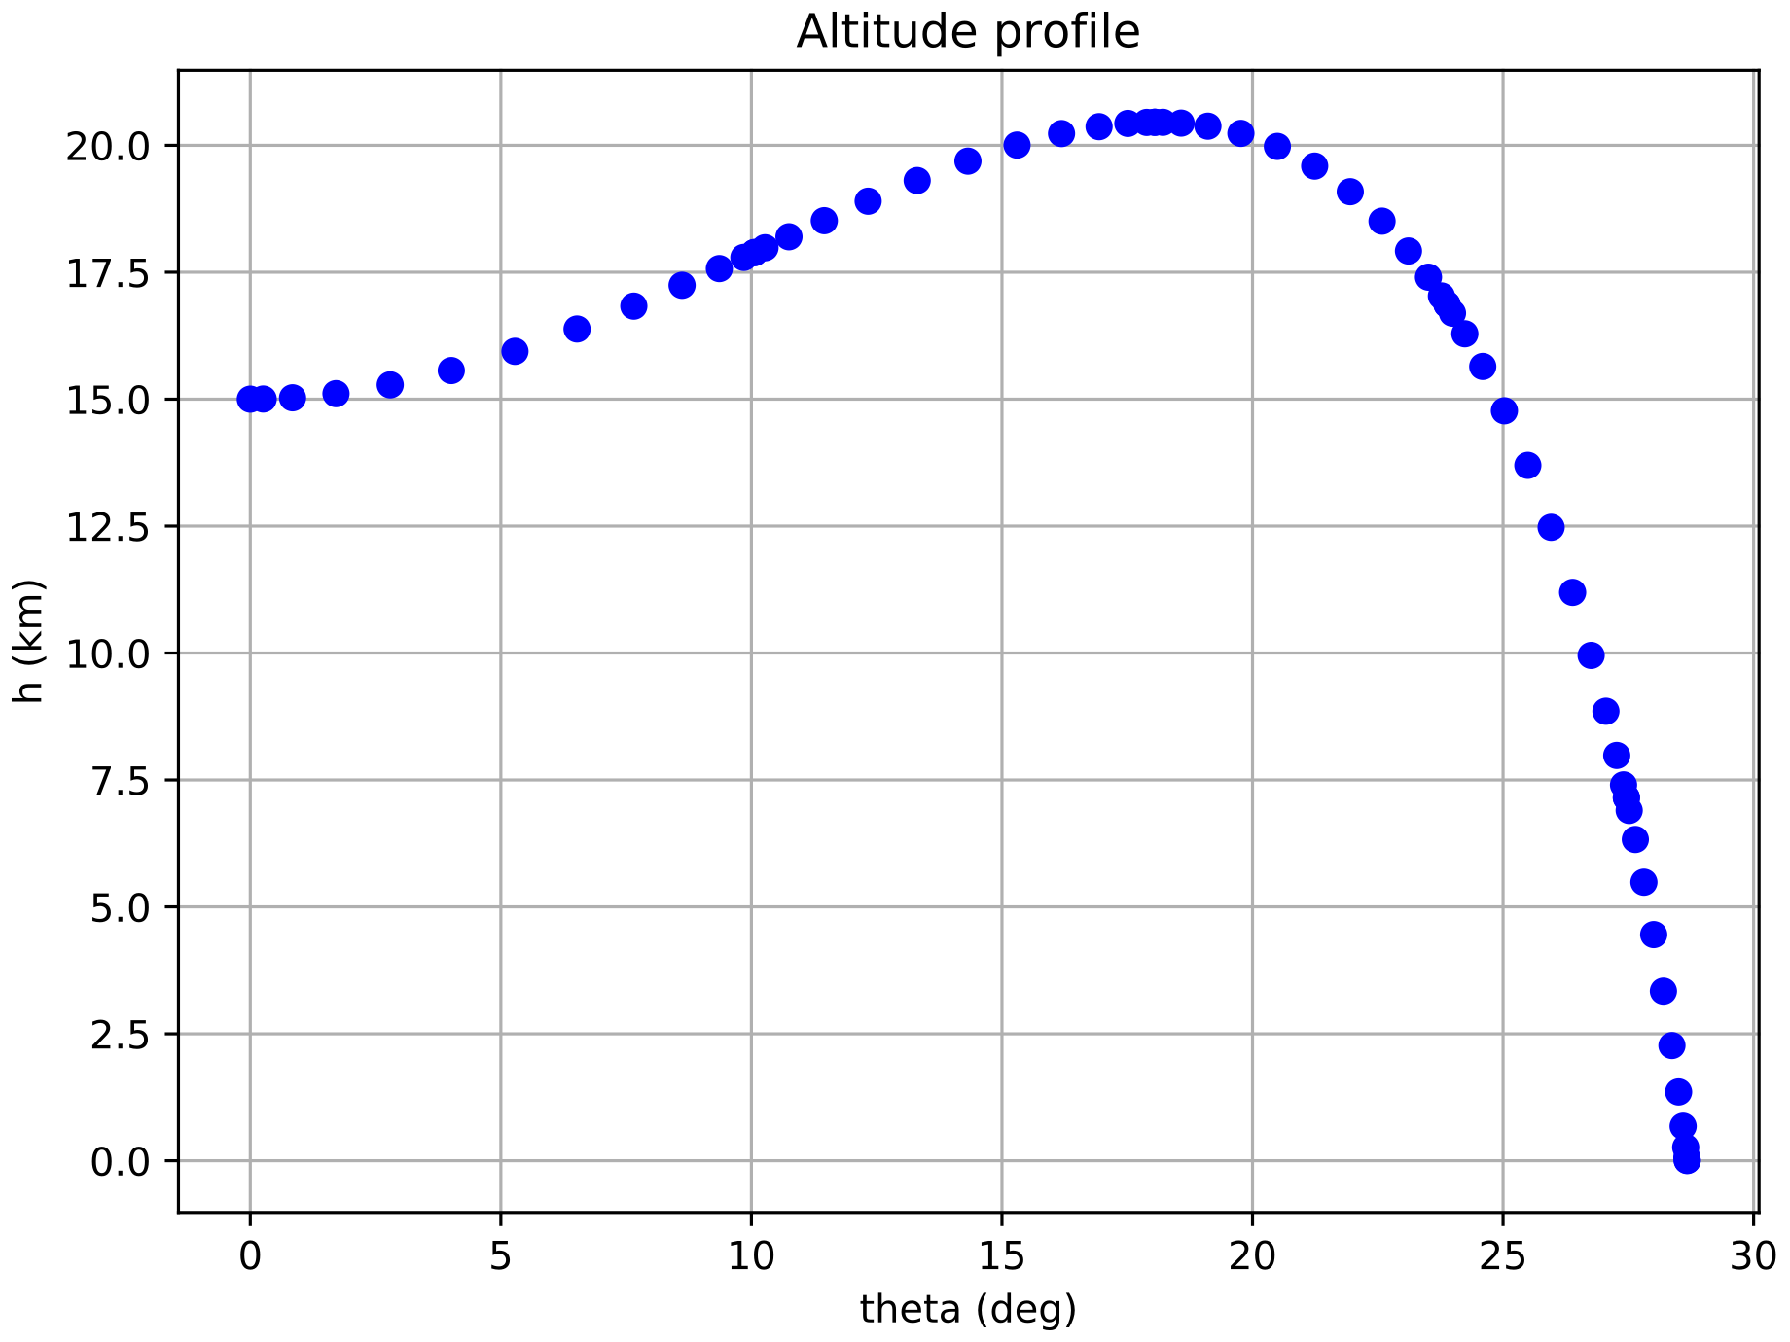
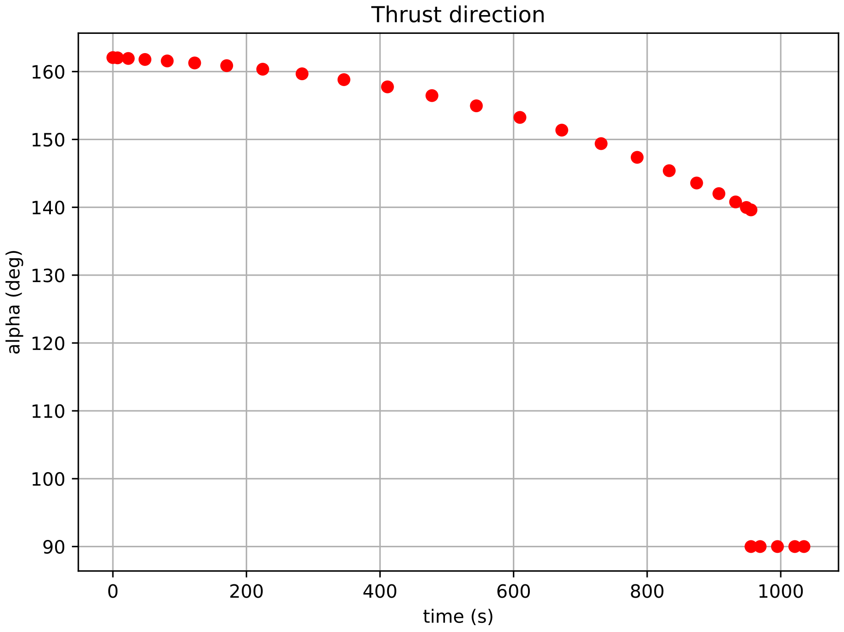
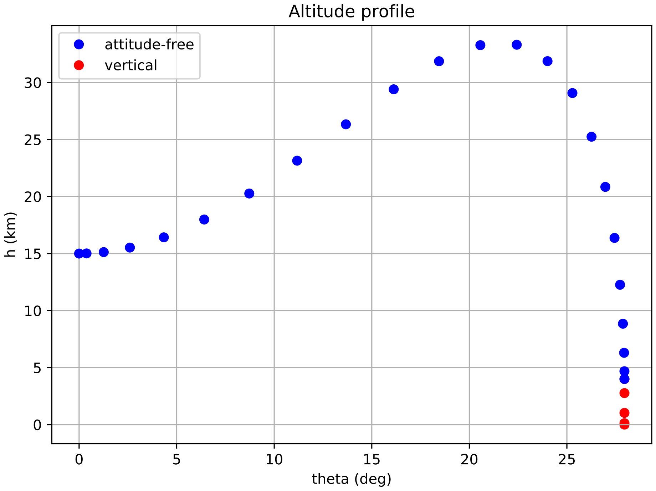
Achievements of Semester 2
Descent Trajectory without final constraints
Descent Trajectory with final constraints
Parking orbit altitude | 100 km
Powered descent phase initial altitude | 15 km
Vertical phase initial altitude | 4 km
Parameters
Isp | 310s
twr | 0.9
 | Time of Flight | Propellant consumption
Free | 999.05 s | 48.51%
Vertical constrained | 1034.77 s | 50.24%
Notes:
Giuliana

Slide 9
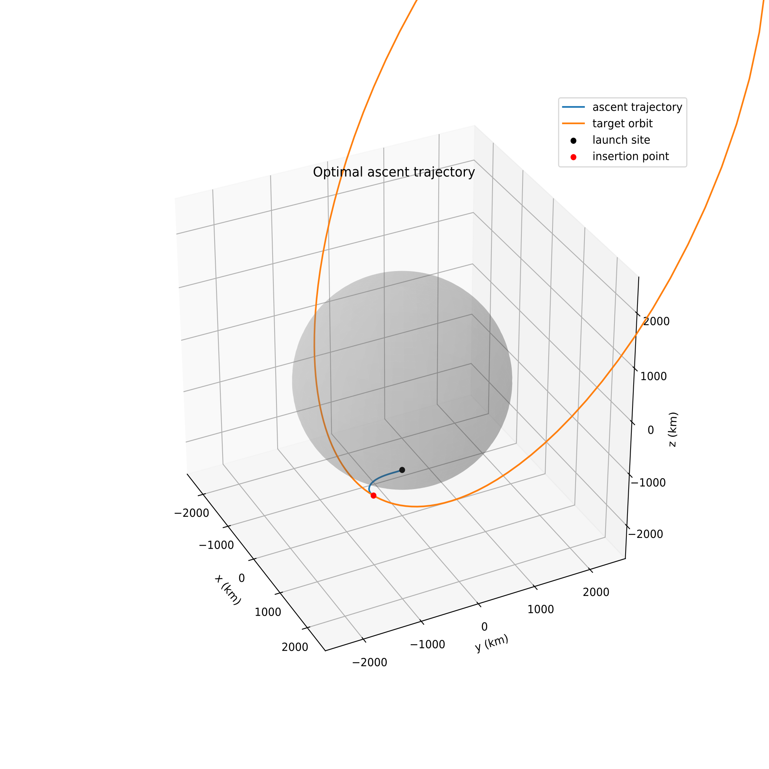
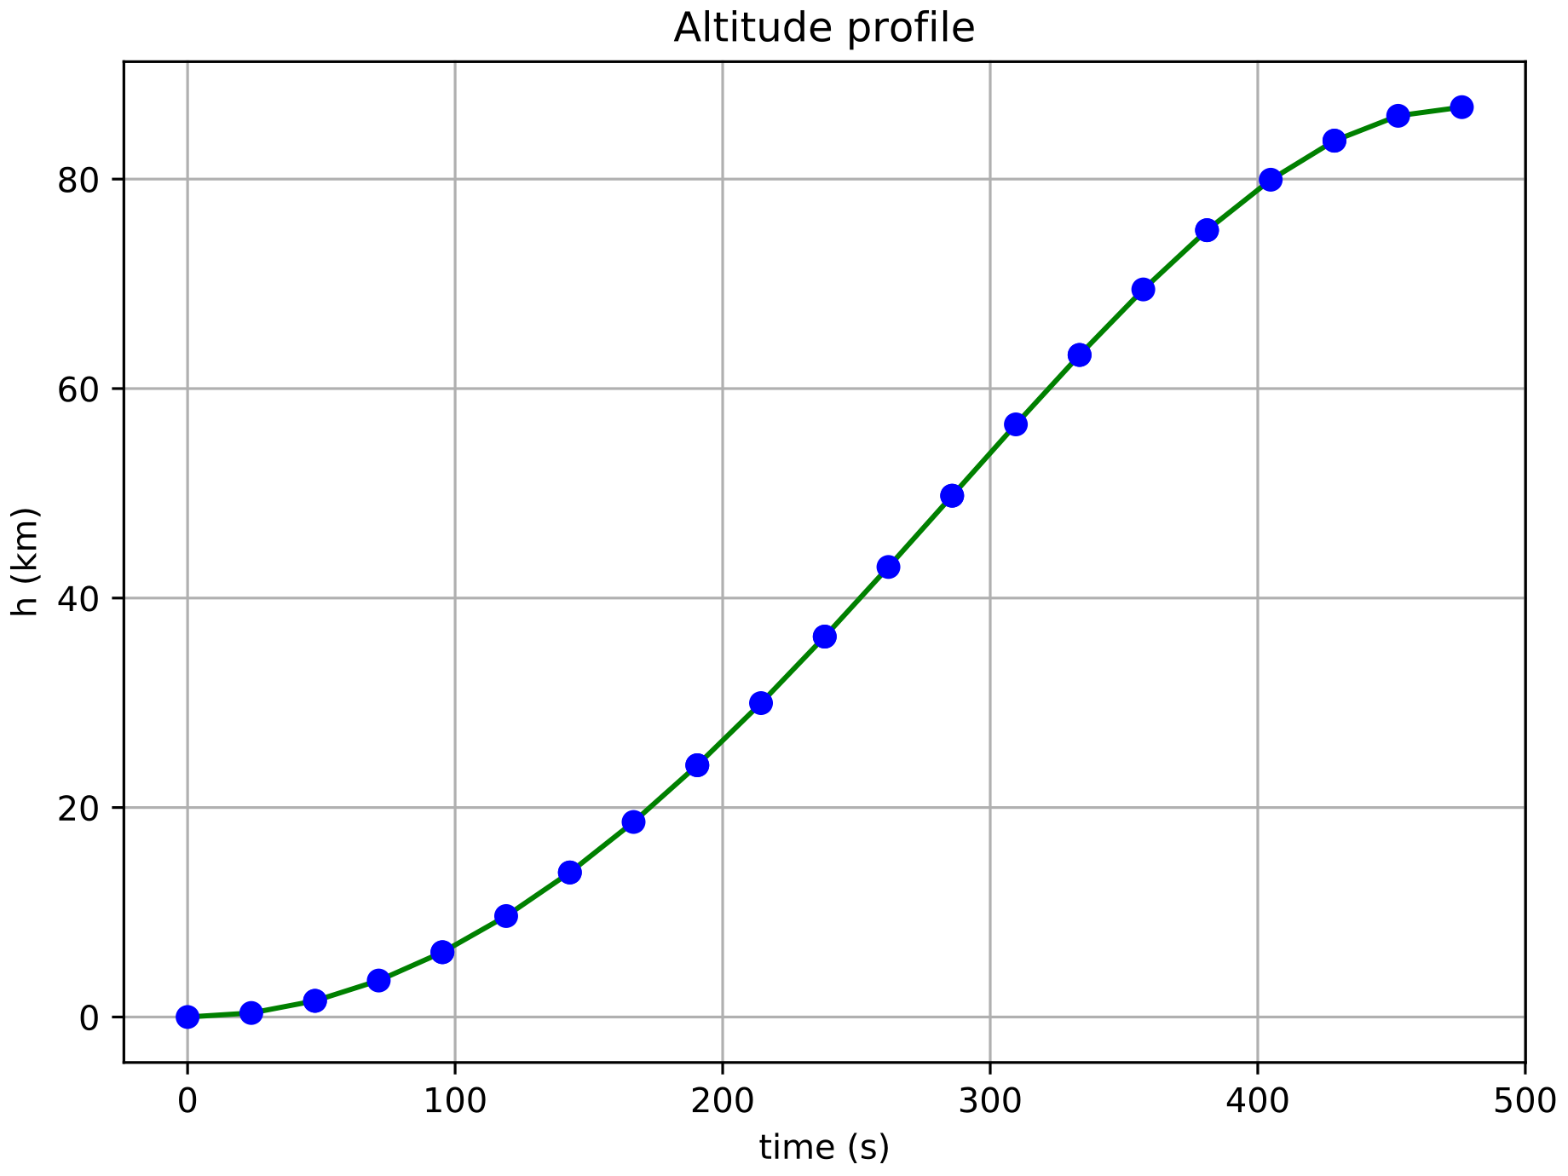
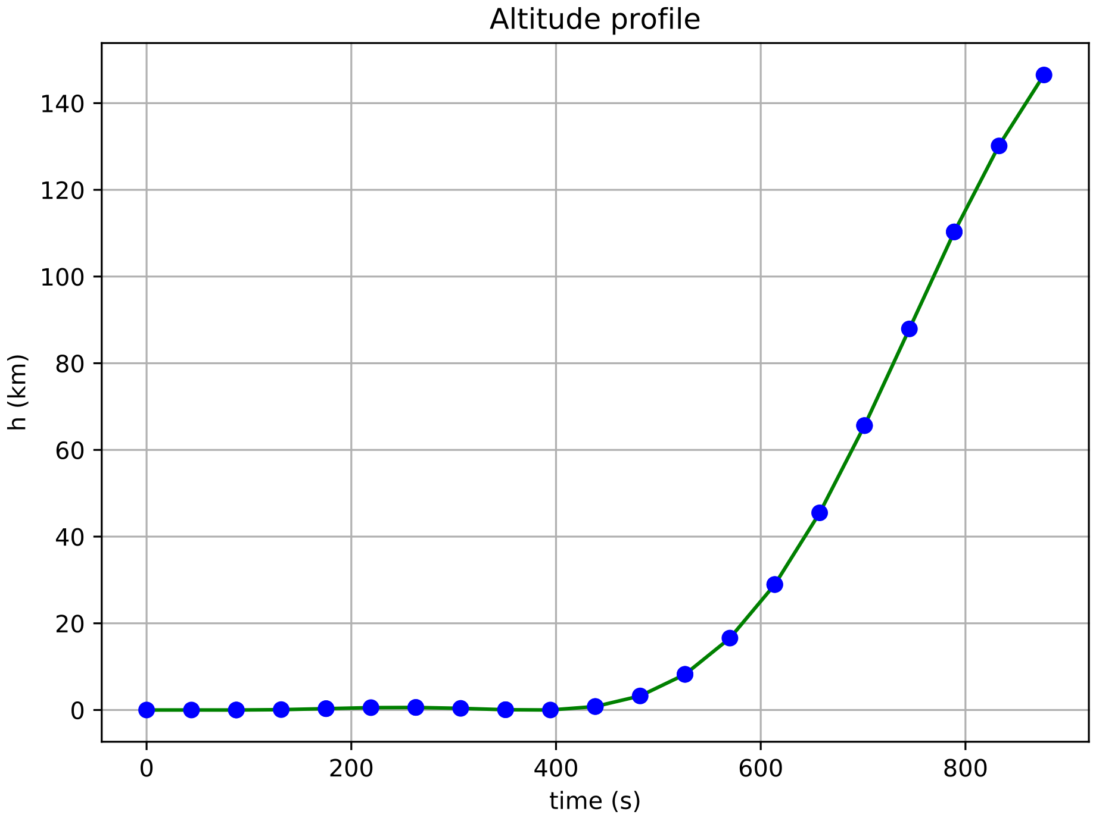
Achievements of Semester 2
Polar orbit - coplanar transfer
Highly elliptical orbit - out-of-plane maneuver
Type of orbit | Eccentricity | Inclination | Argument of periapsis | Semimajor axis | Time of flight | Propellant consumption
Polar | 0 | 90° | - | 1824.27 km | 476.29 s | 36.81%
Highly elliptical | 0.7 | 60° | 270° | 6080.90 km | 876.73 s | 67.76%
Notes:
Giuliana

Slide 10
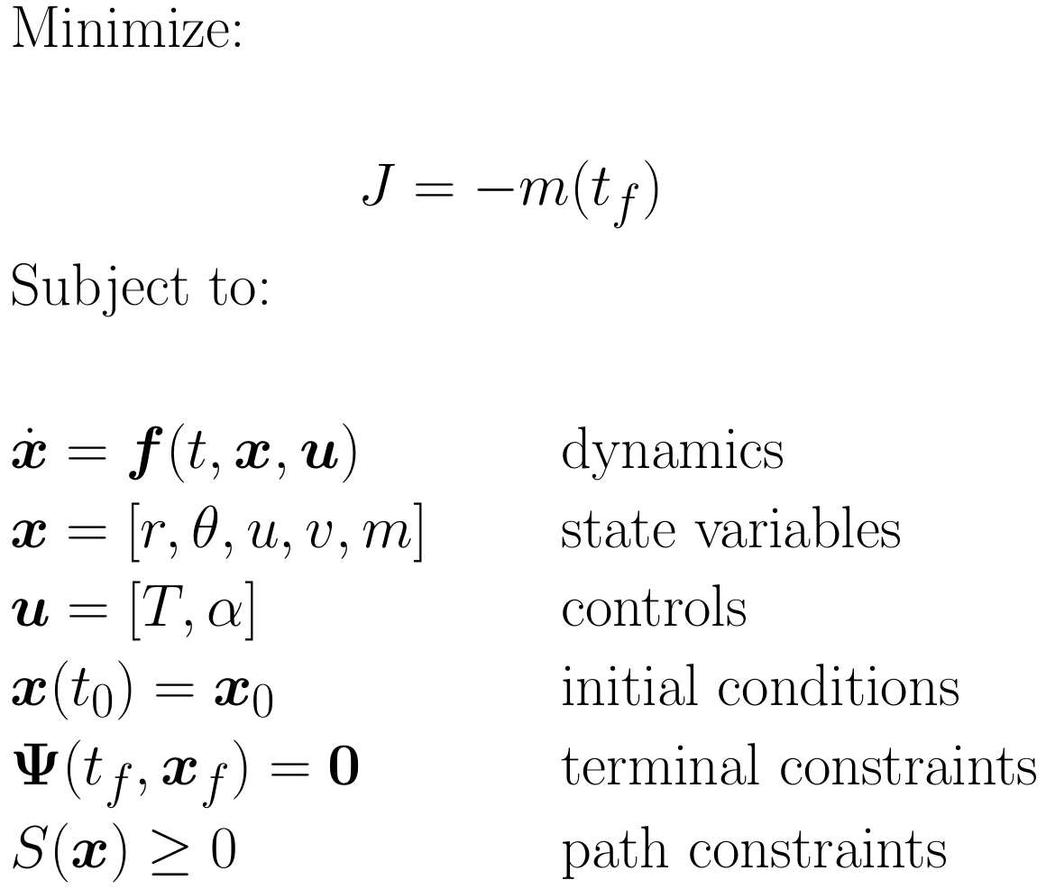
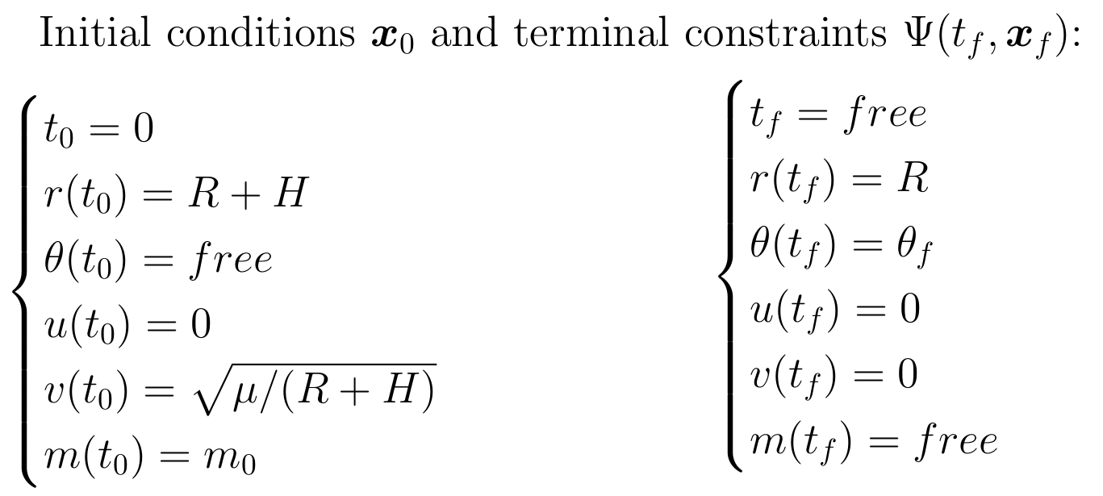
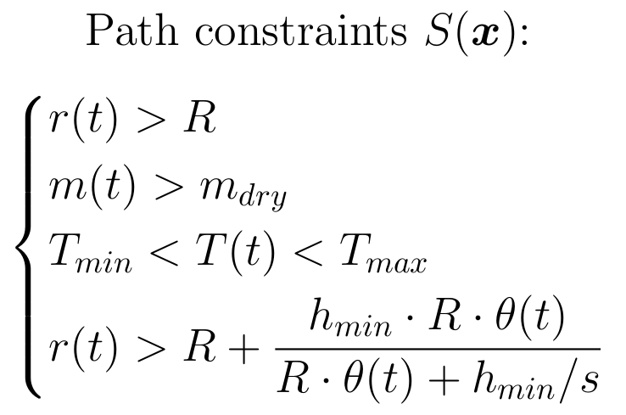
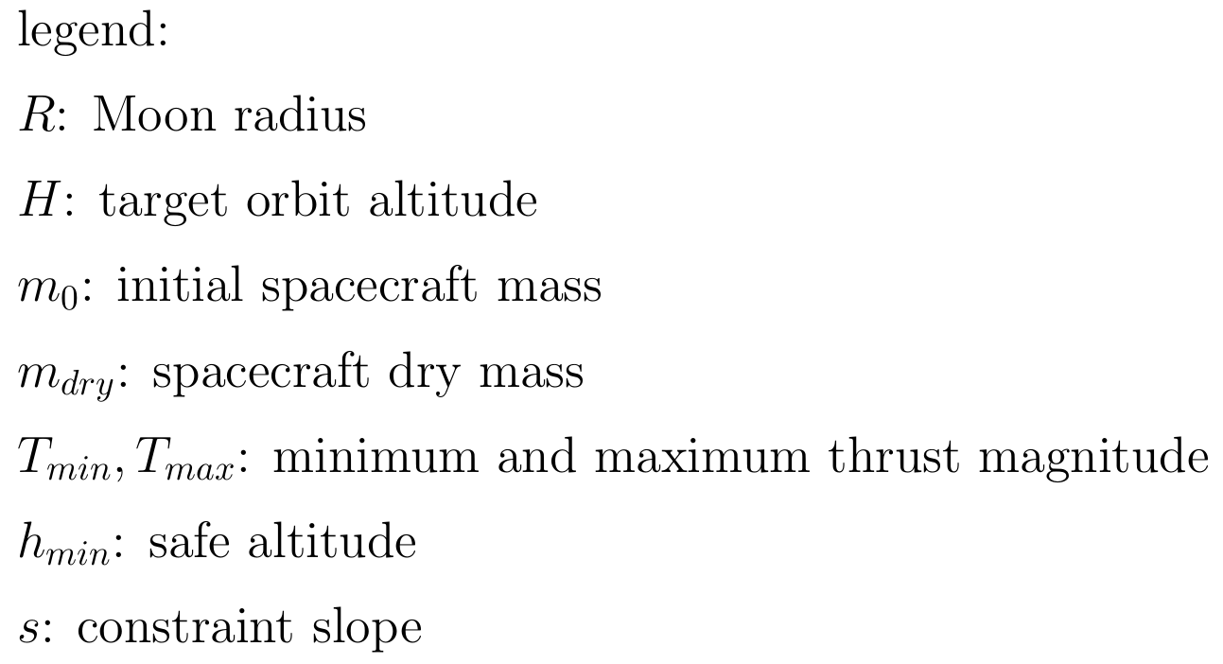
2D Descent: Optimal control problem
Notes:
Alberto

Slide 11
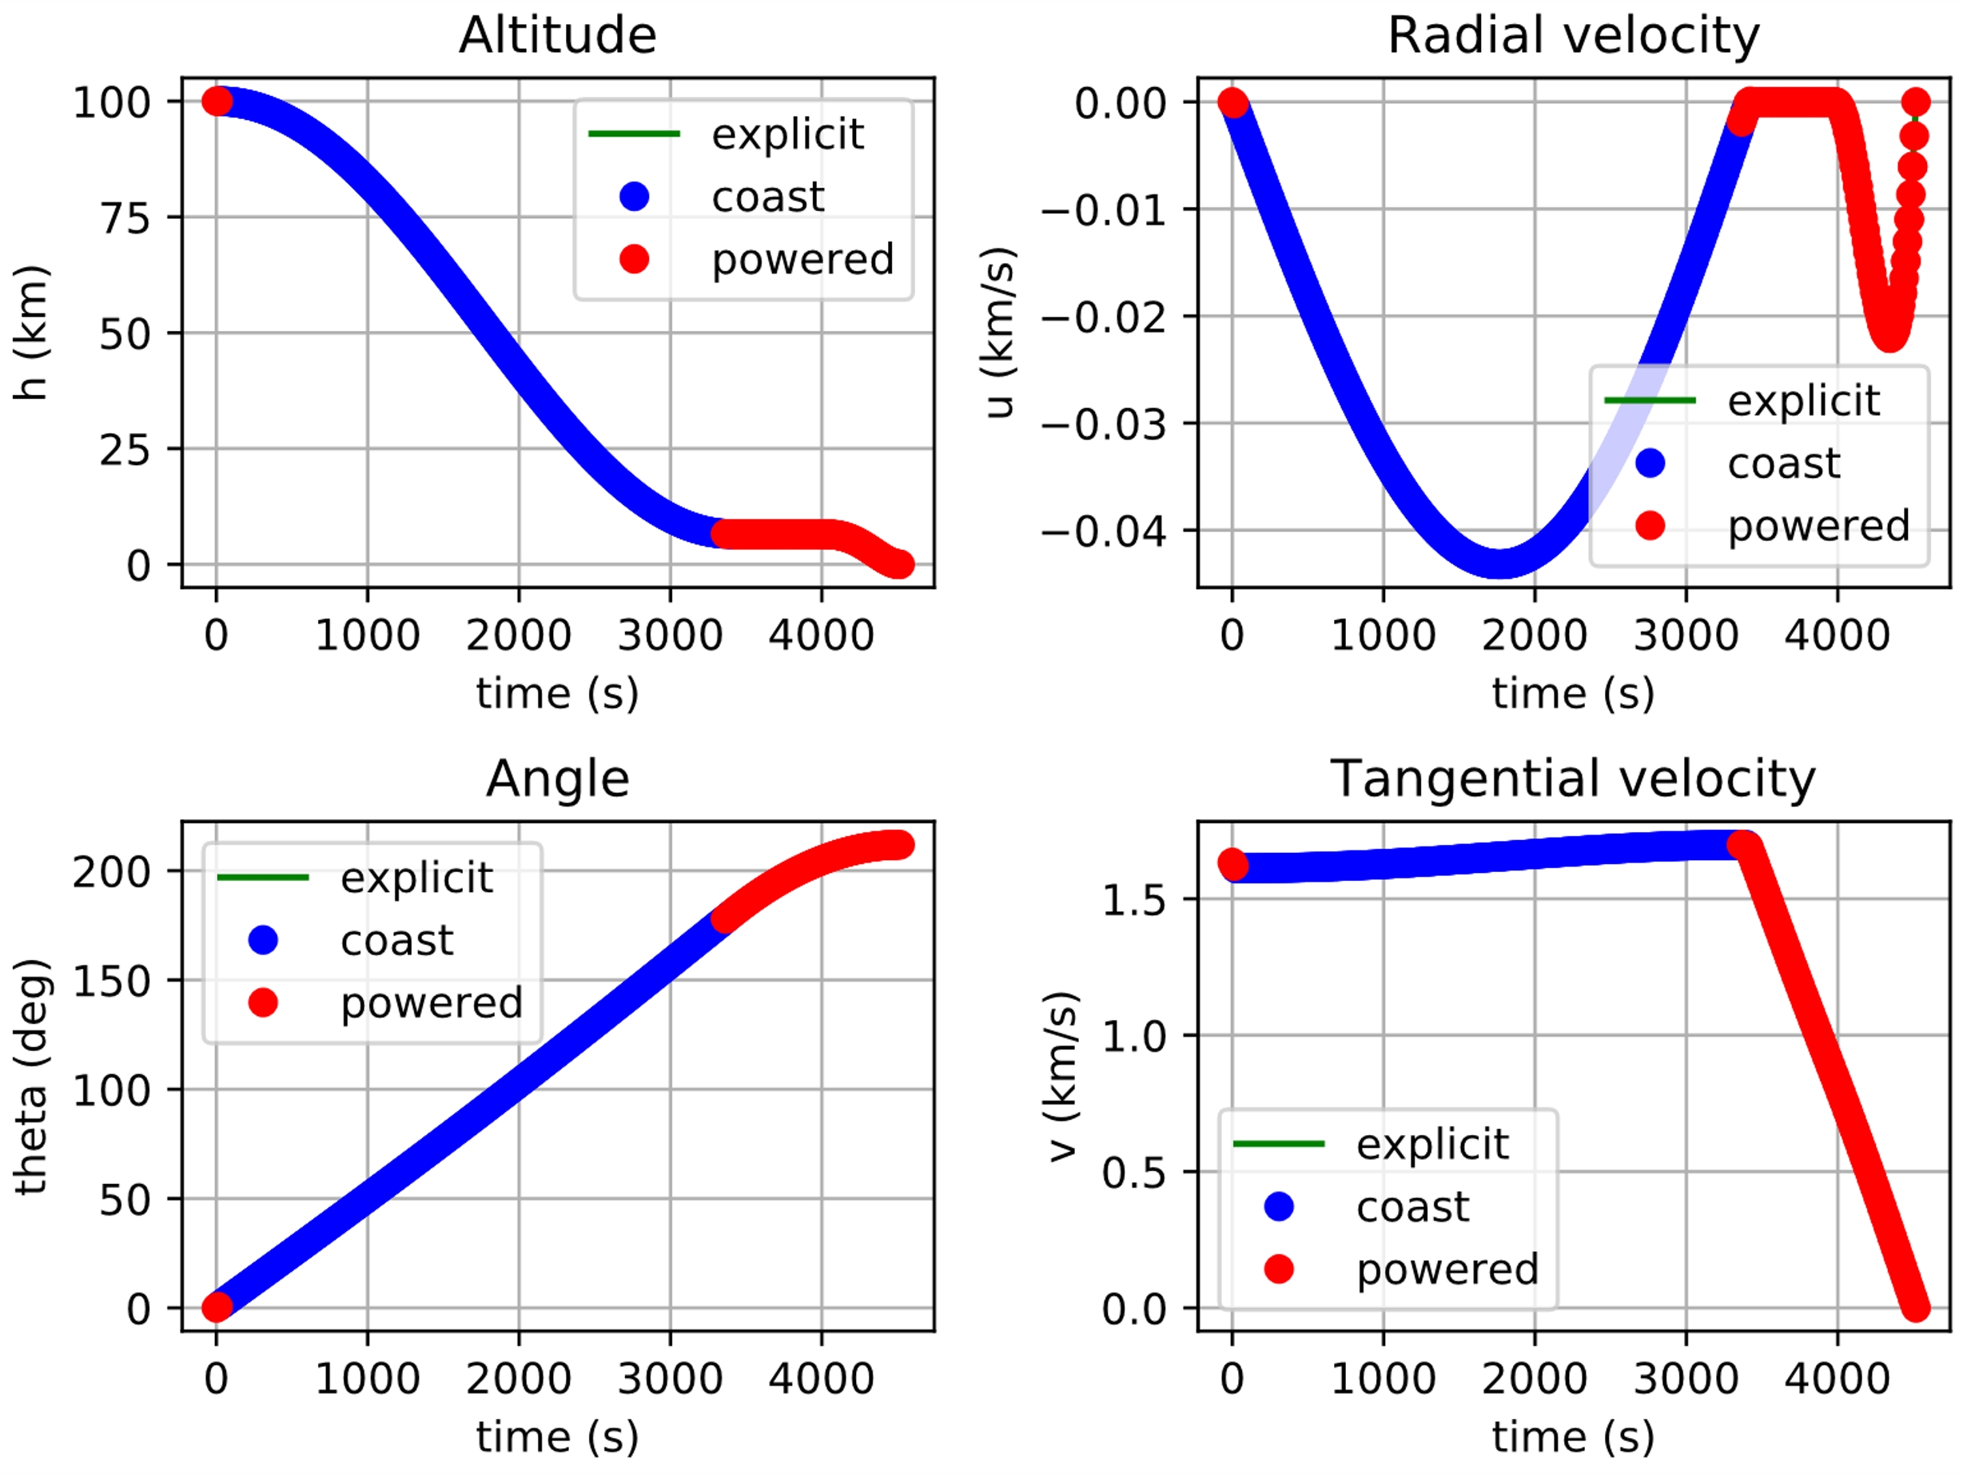
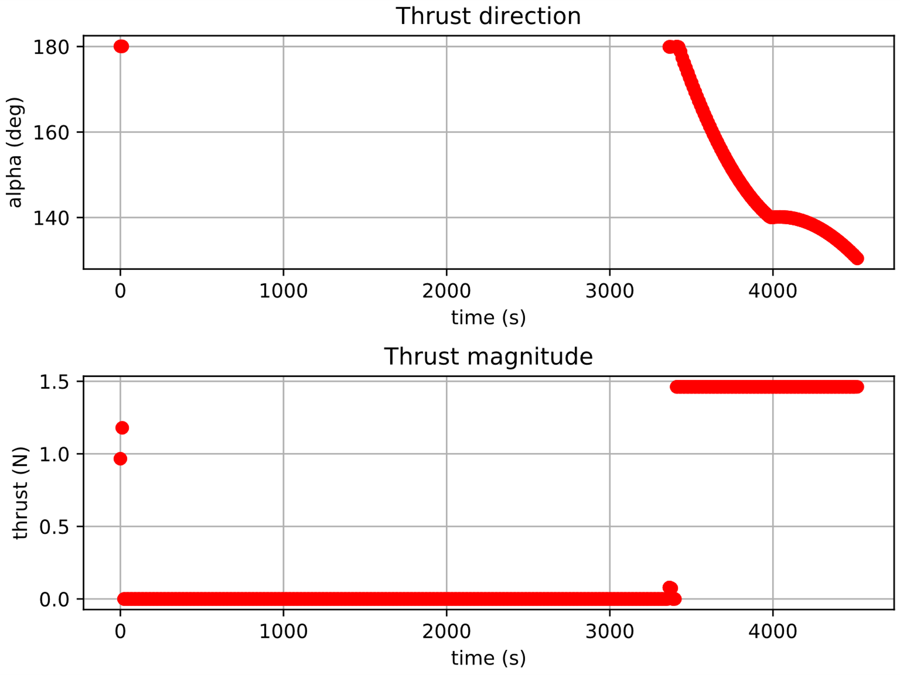
2D Descent: Variable thrust
h | Isp | twr
100 km | 400 s | 0.9
Time of Flight | Propellant consumption
4516.7708 s | 41.97%
Notes:
Alberto

Slide 12
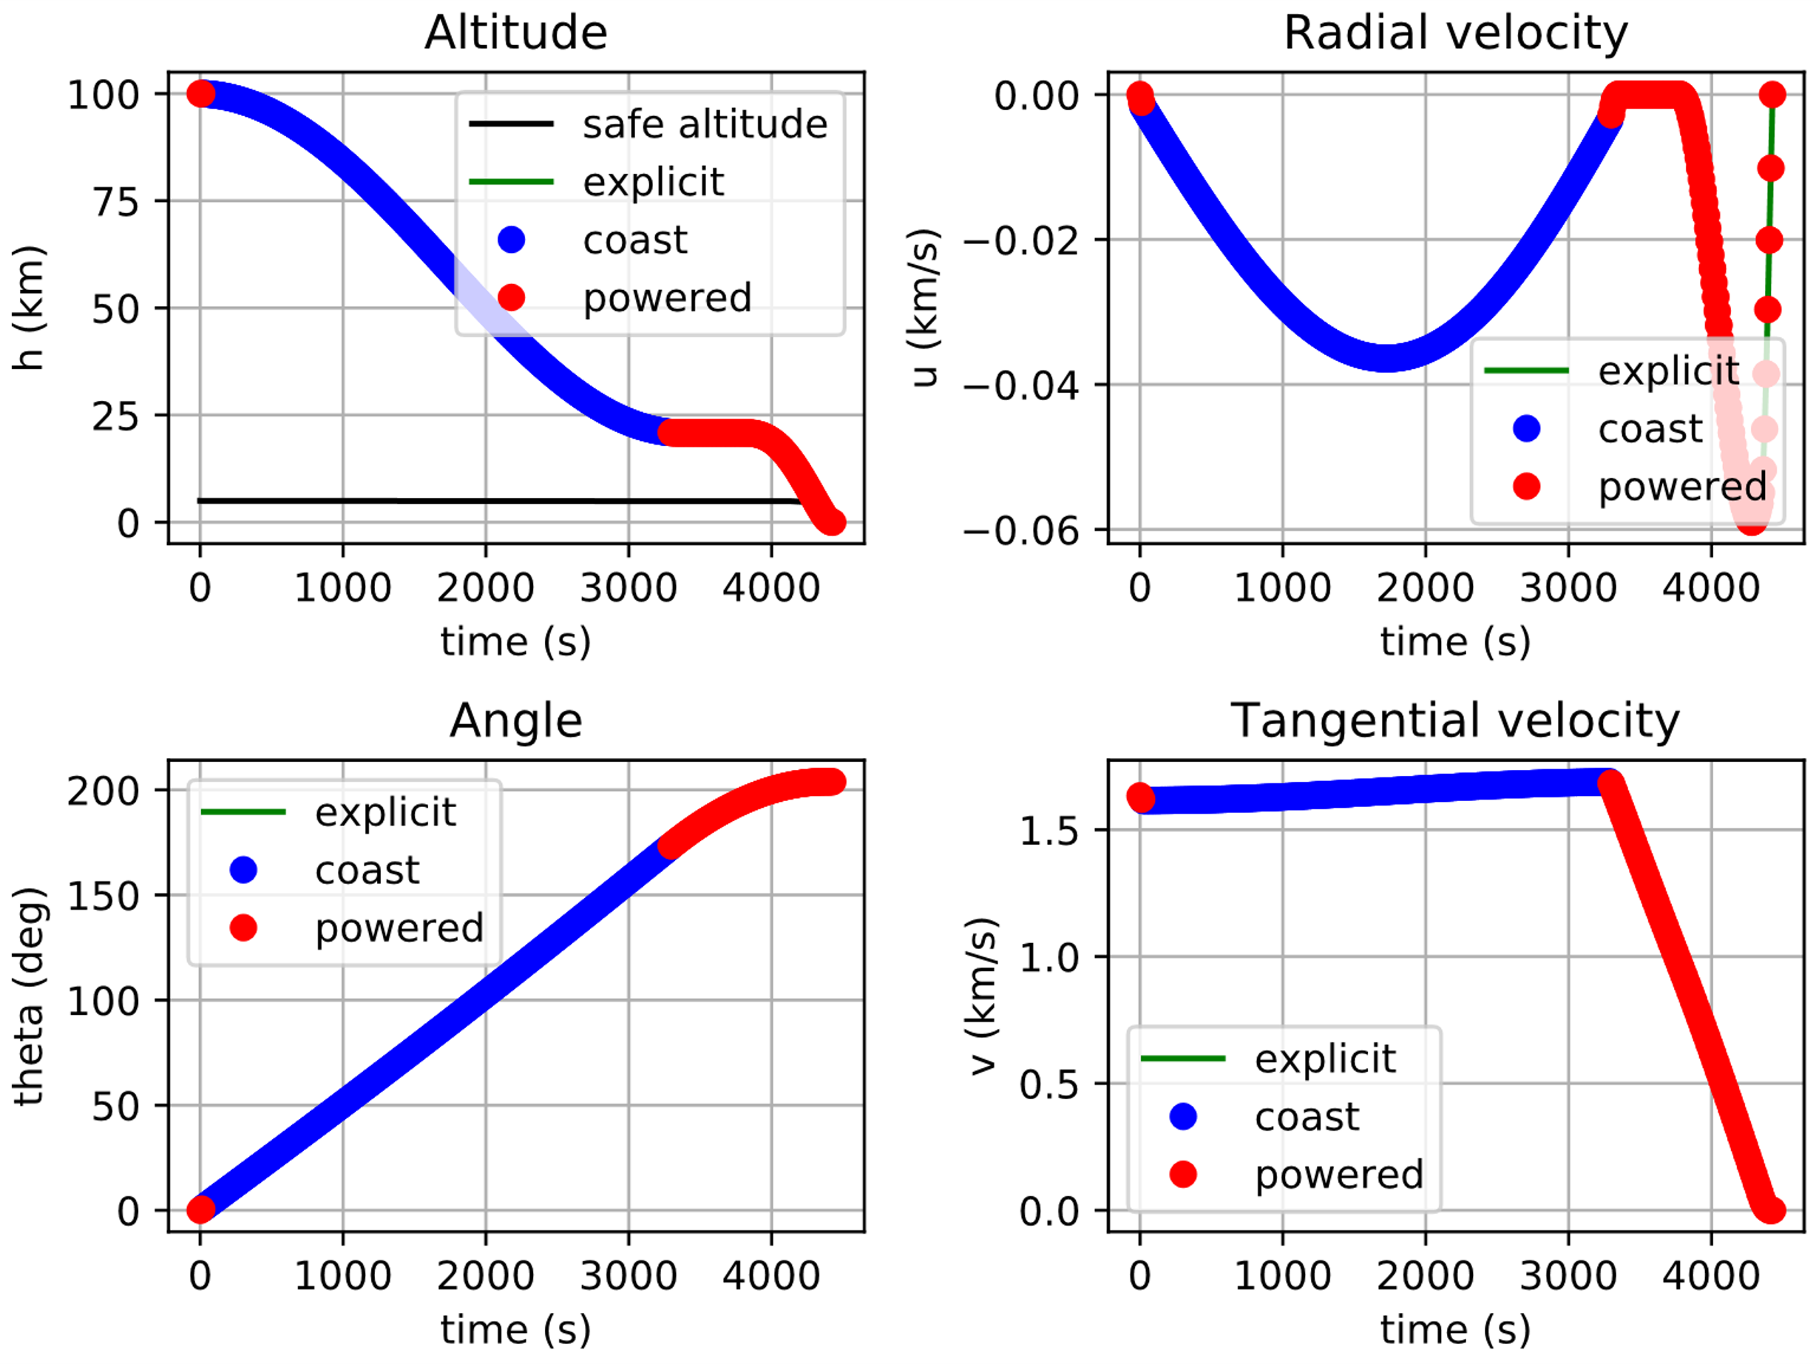
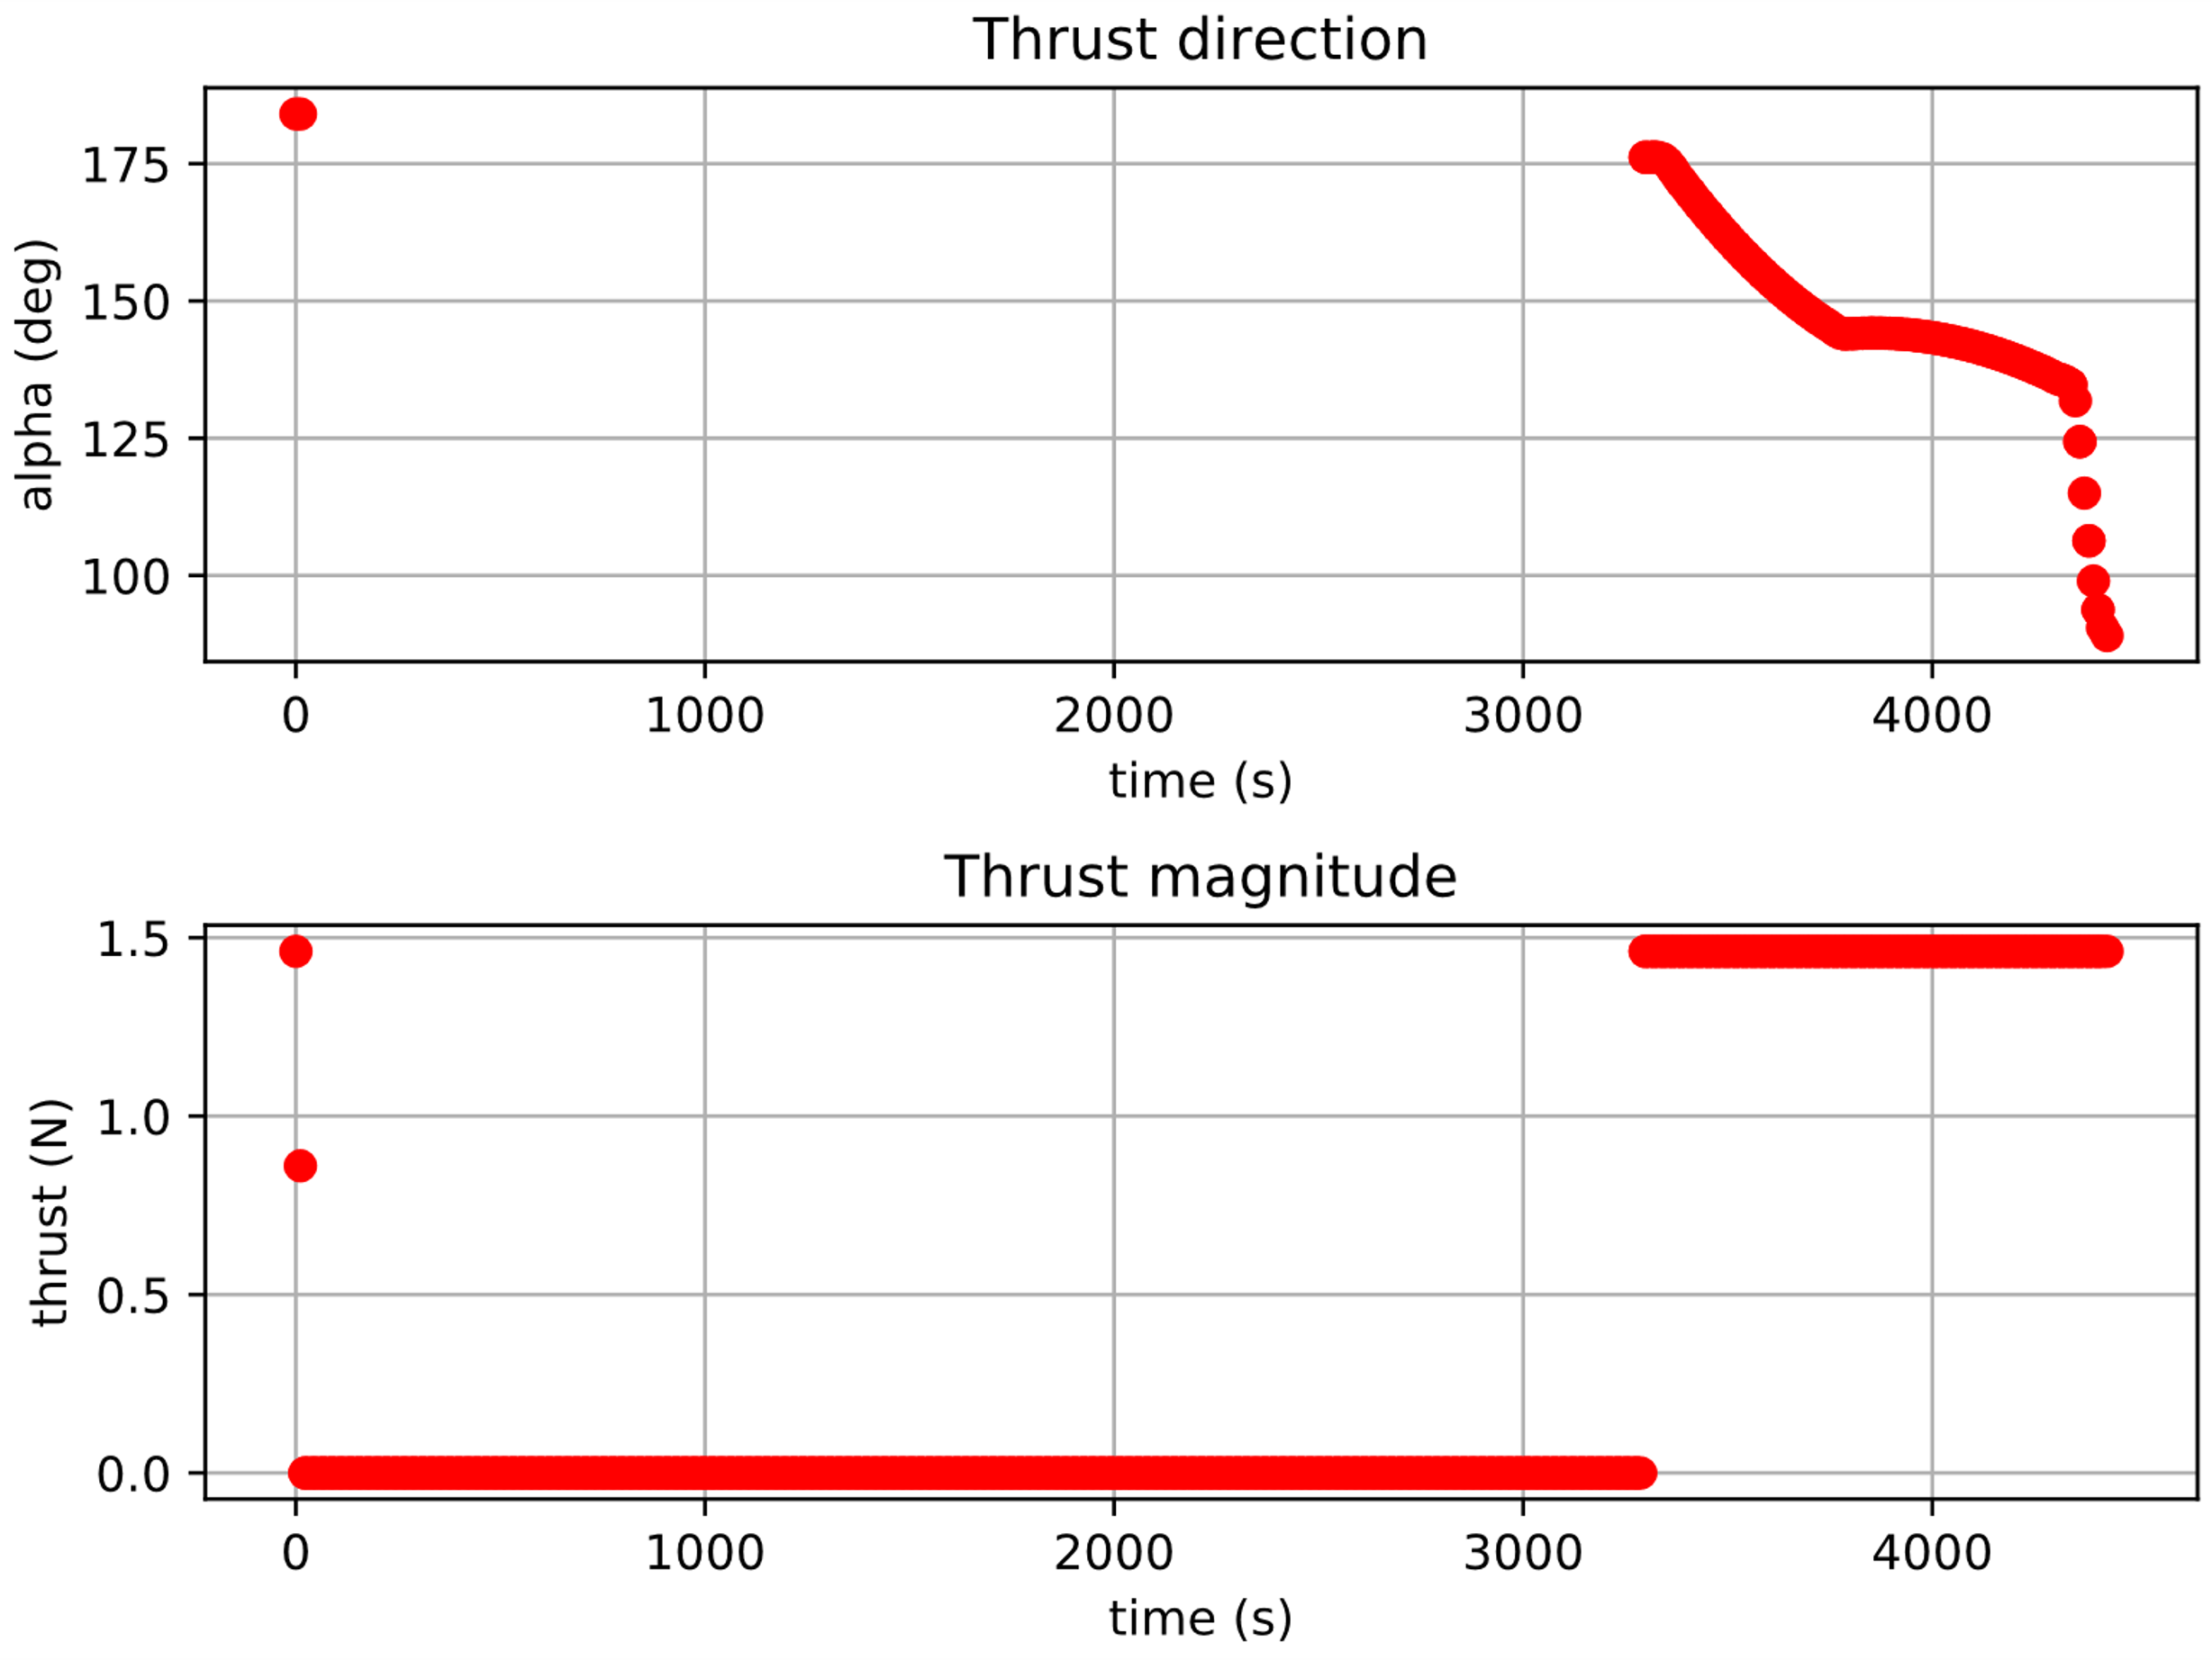
2D Descent: Minimum safe altitude
h | Isp | twr | h min | s
100 km | 400 s | 0.9 | 5 km | -5
Time of Flight | Propellant consumption
4426.9527 s | 42.67%
Notes:
Alberto

Slide 13
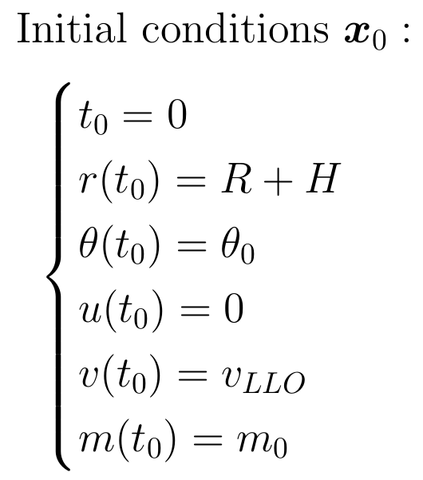
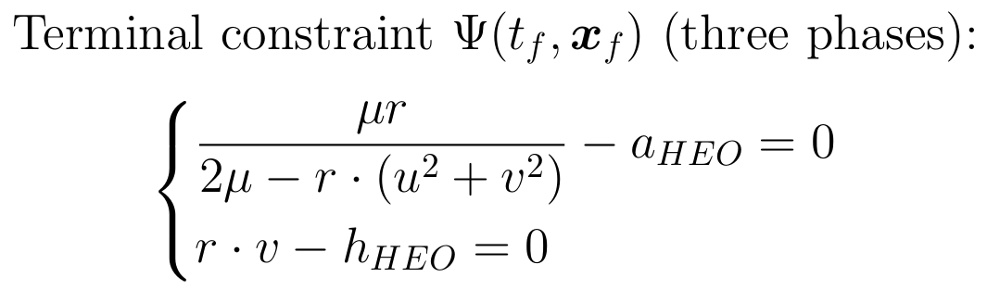
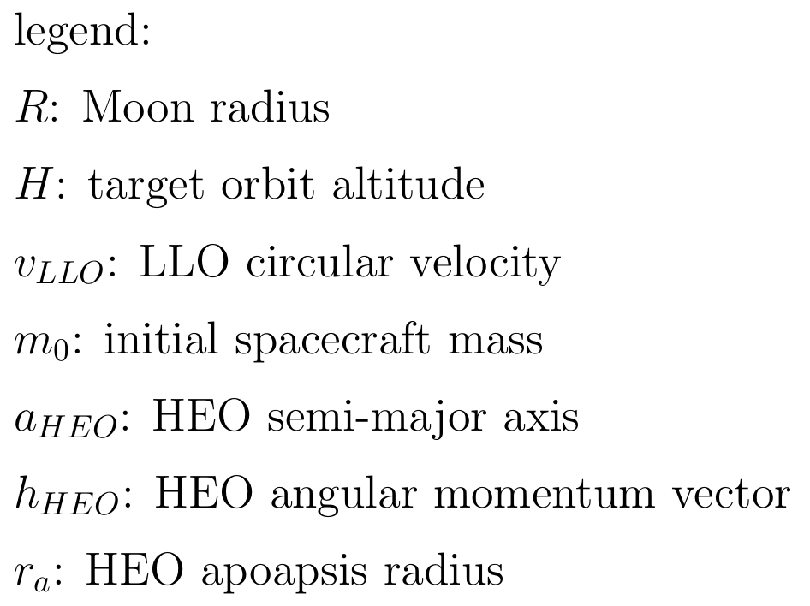
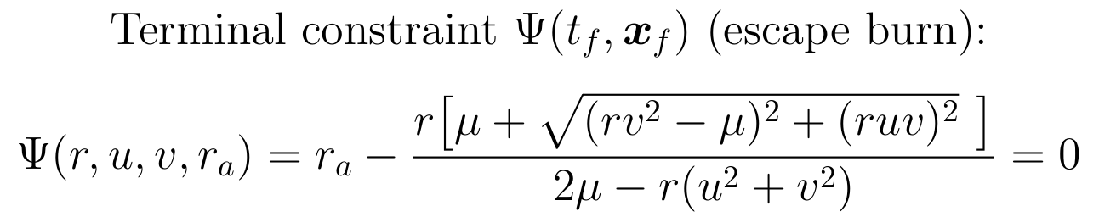
LLO to HEO: Optimal control problem
Notes:
Giuliana

Slide 14
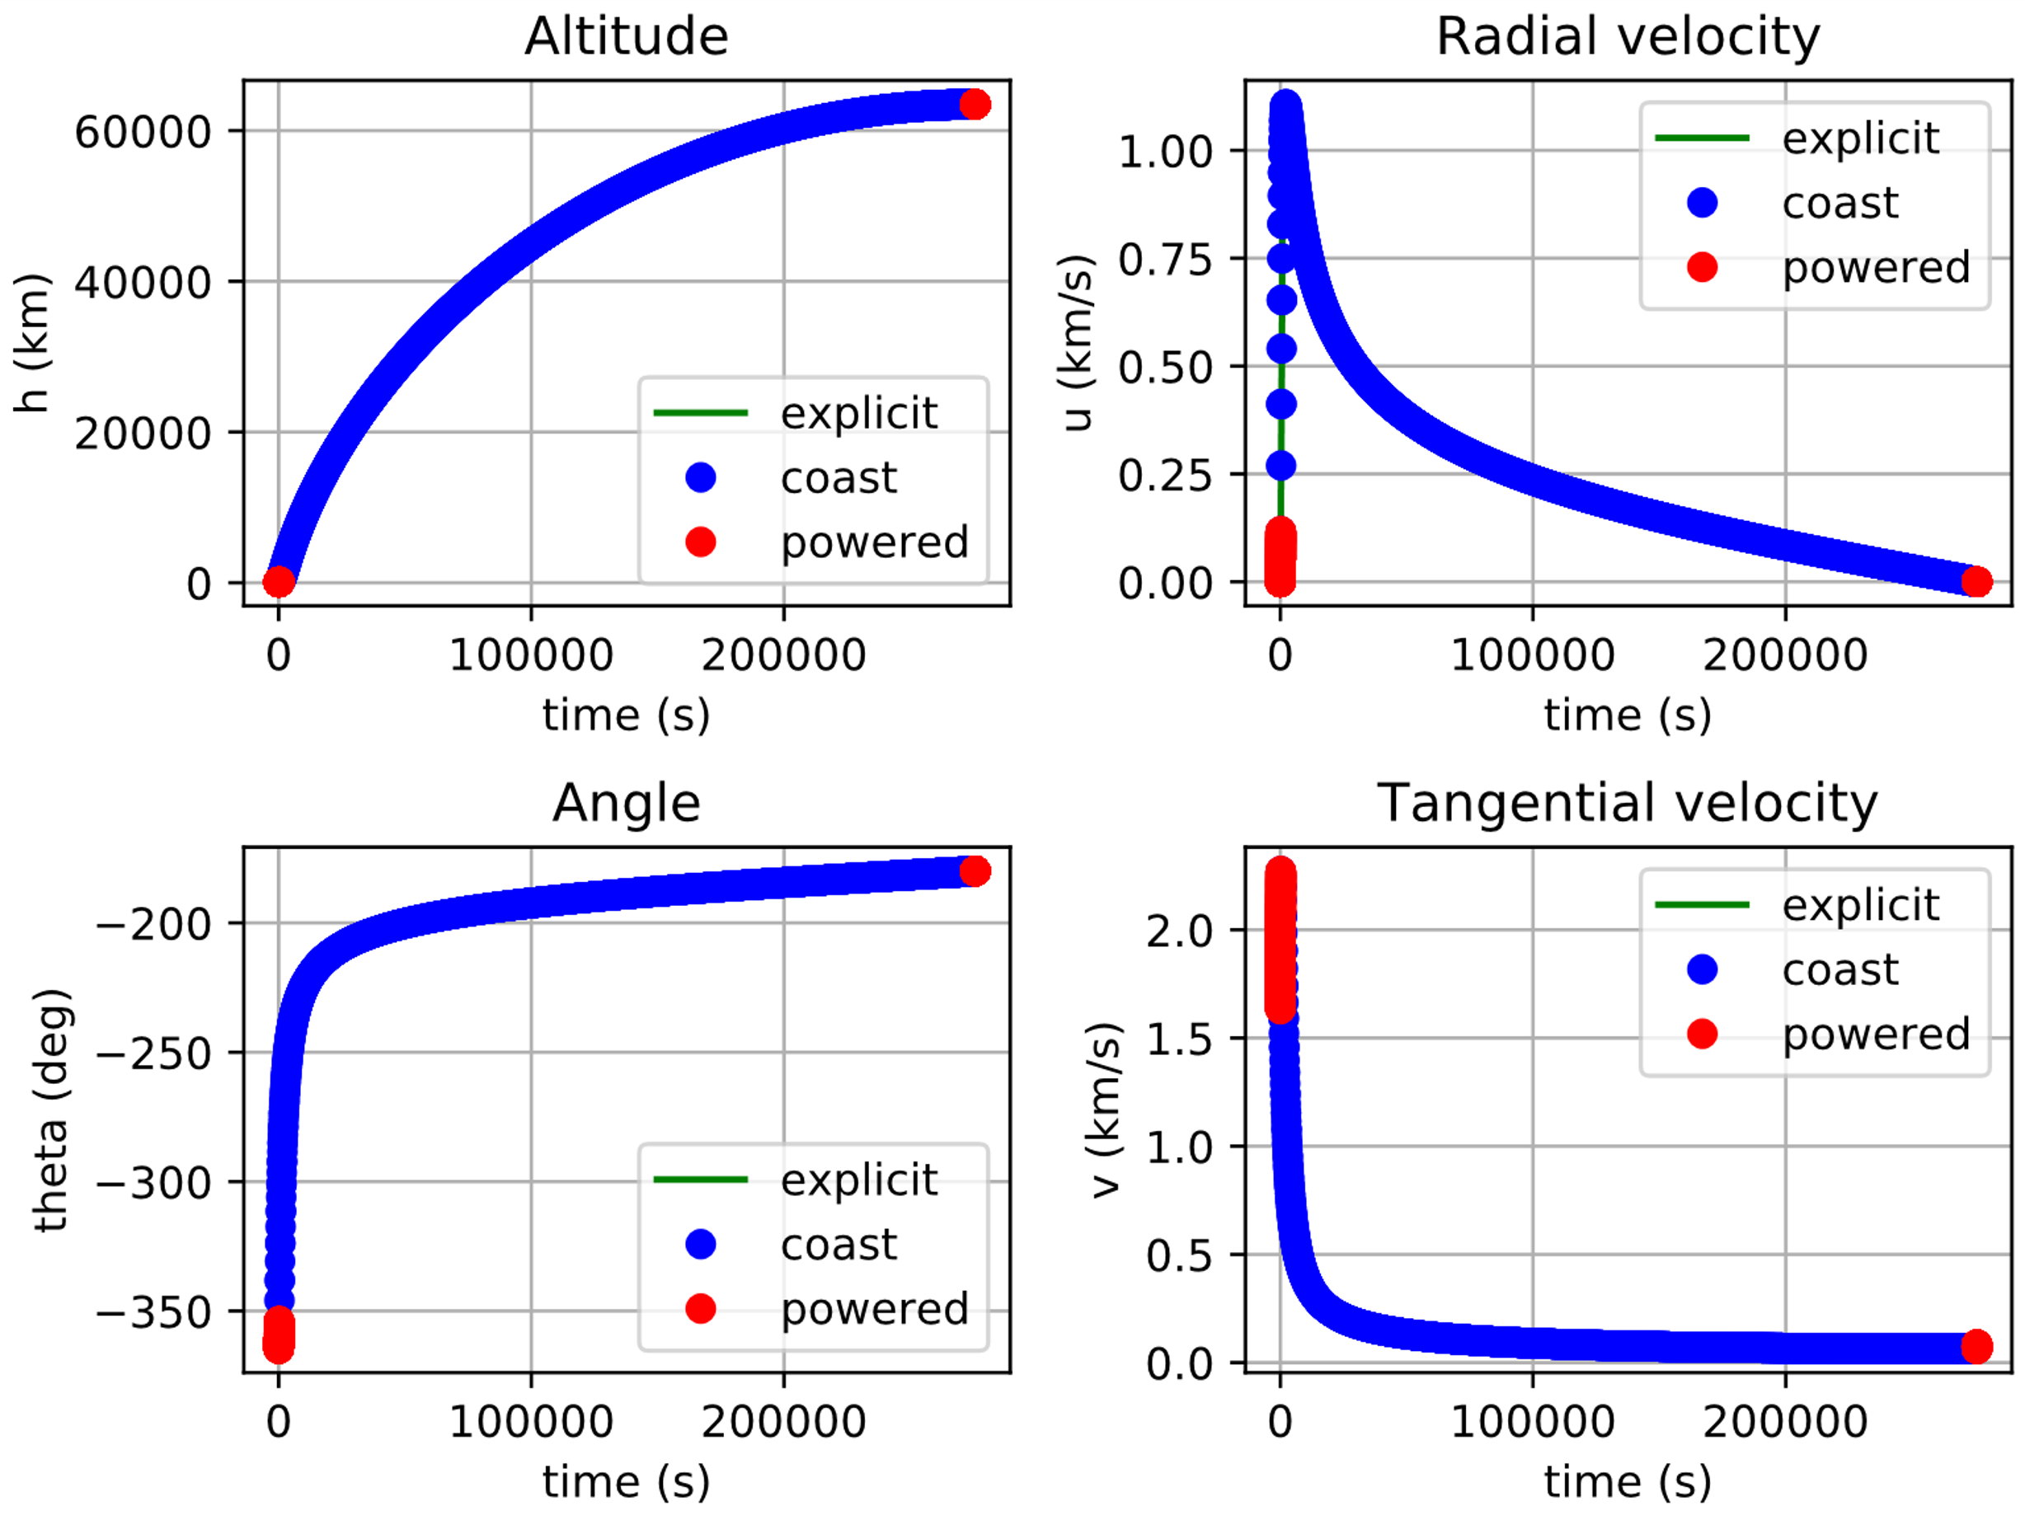
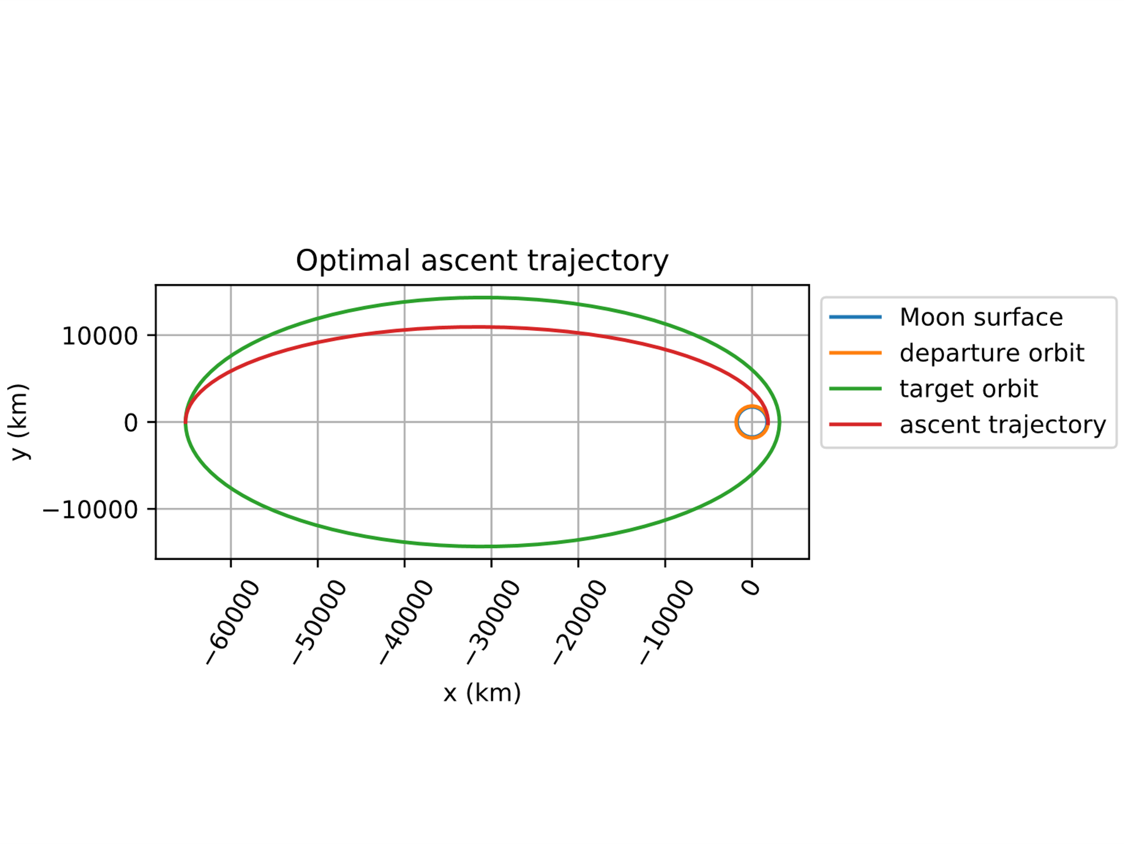
LLO to HEO: Three-phases transfer
 | LLO | HEO
a | 1837.4 km | 34188.7 km
e | 0.0 | 0.9079
Isp | twr
450 s | 2.1
Time of Flight | Propellant consumption
3.1907 days | 13.97%
Notes:
Giuliana

Slide 15
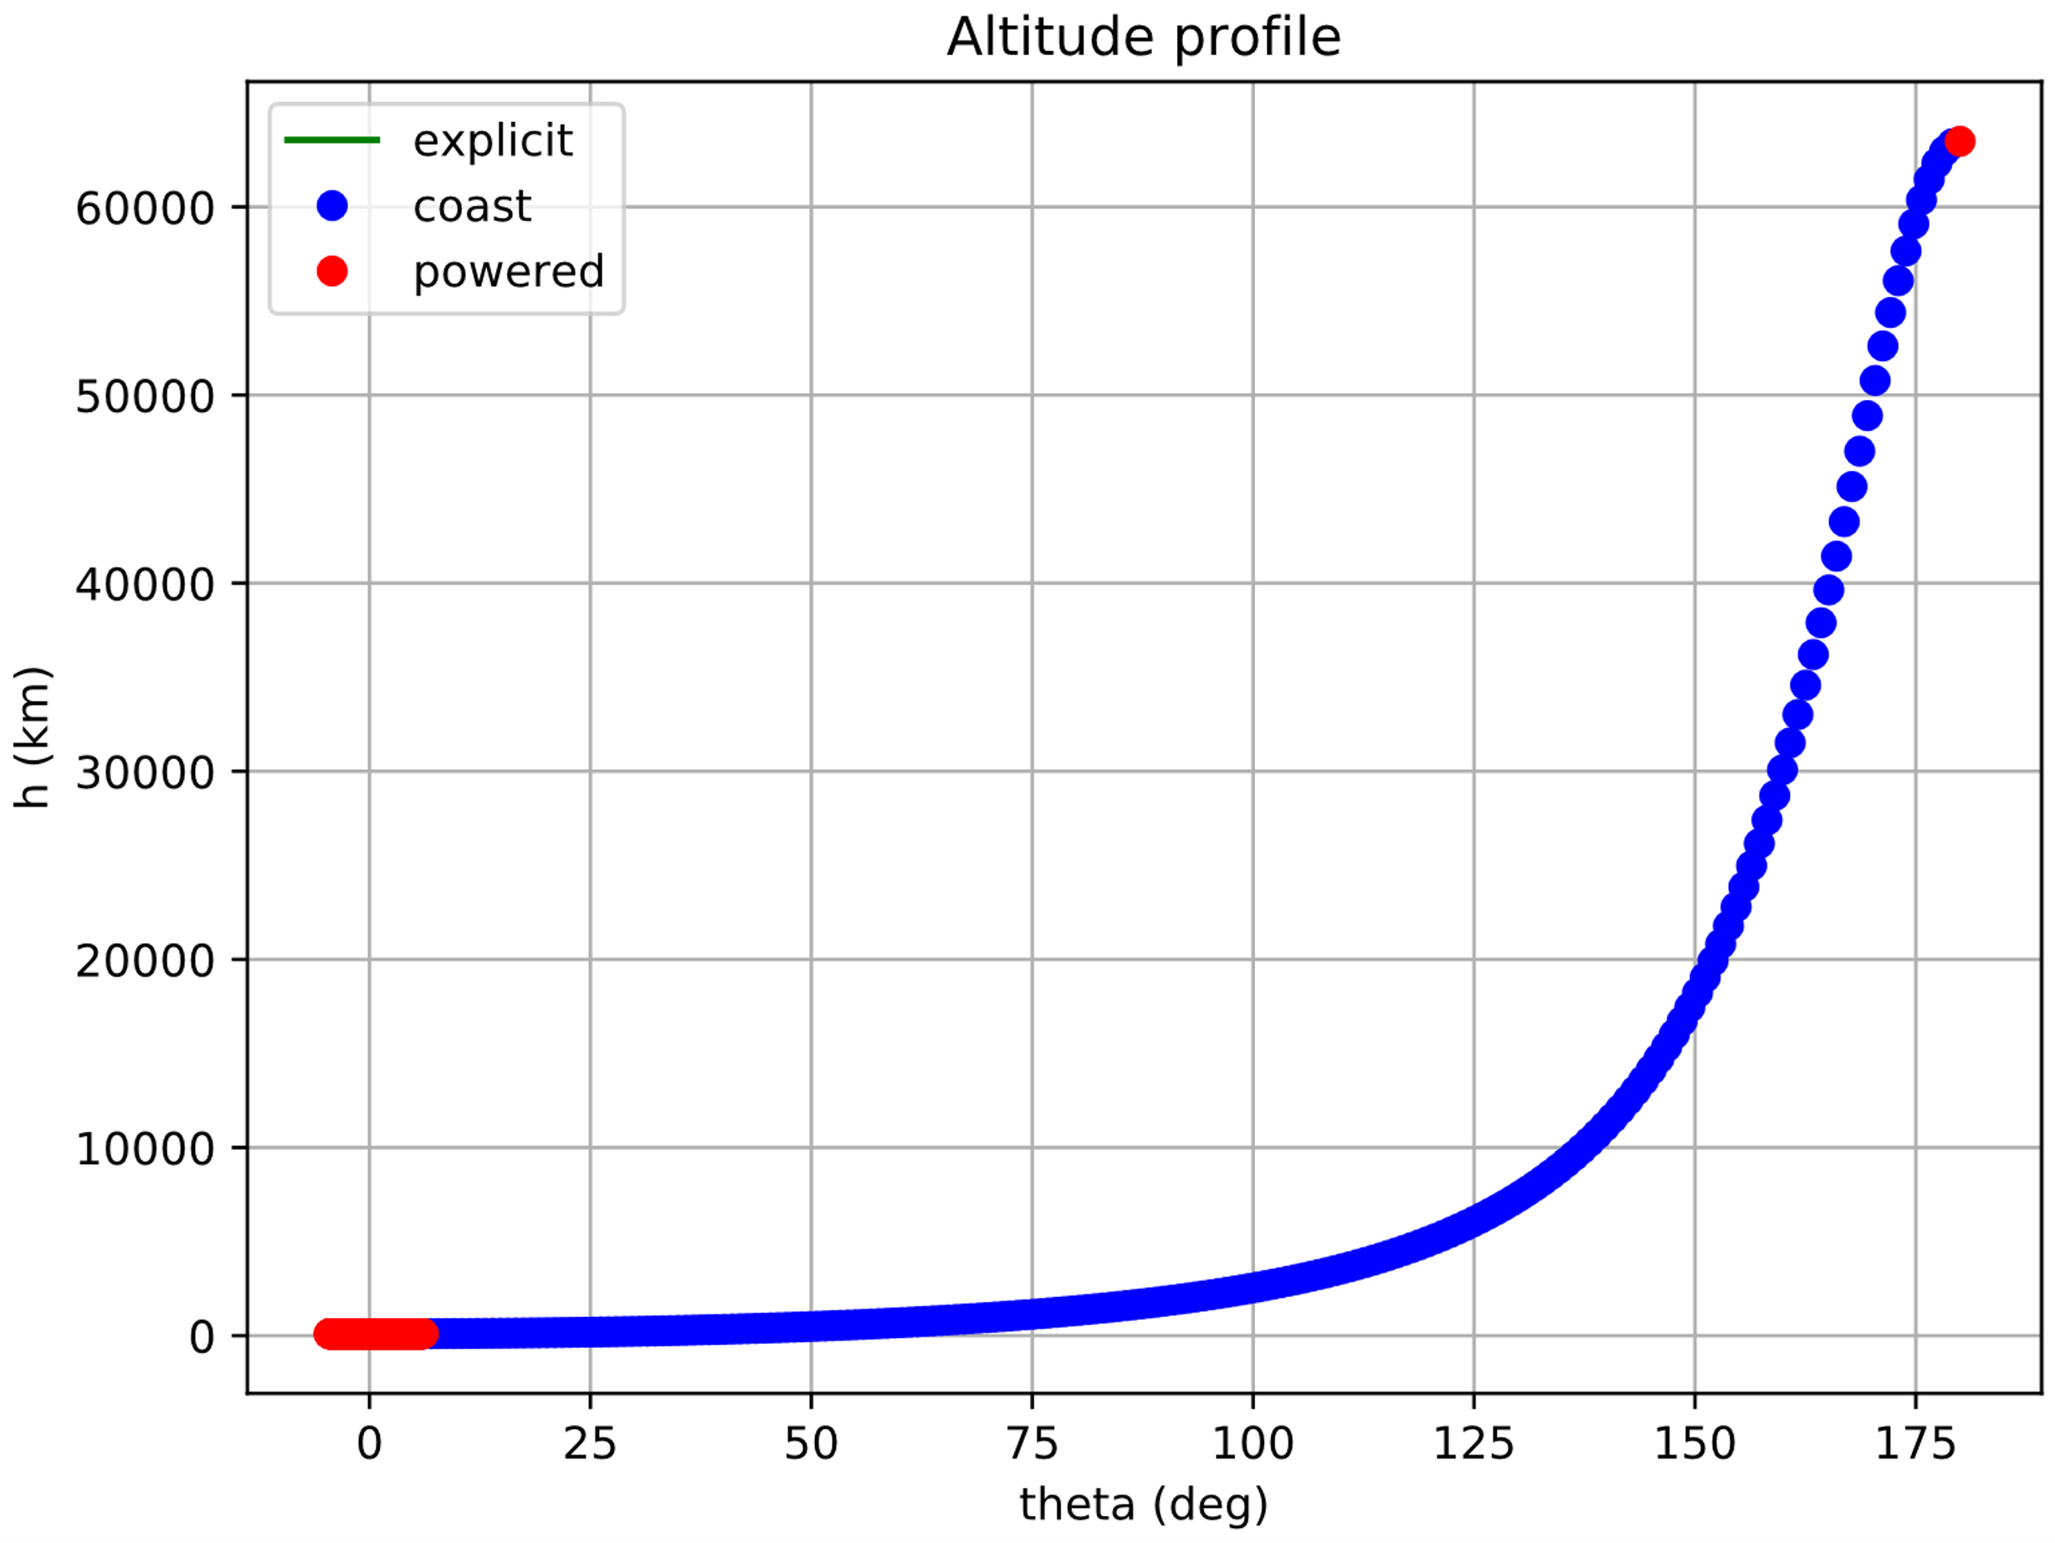
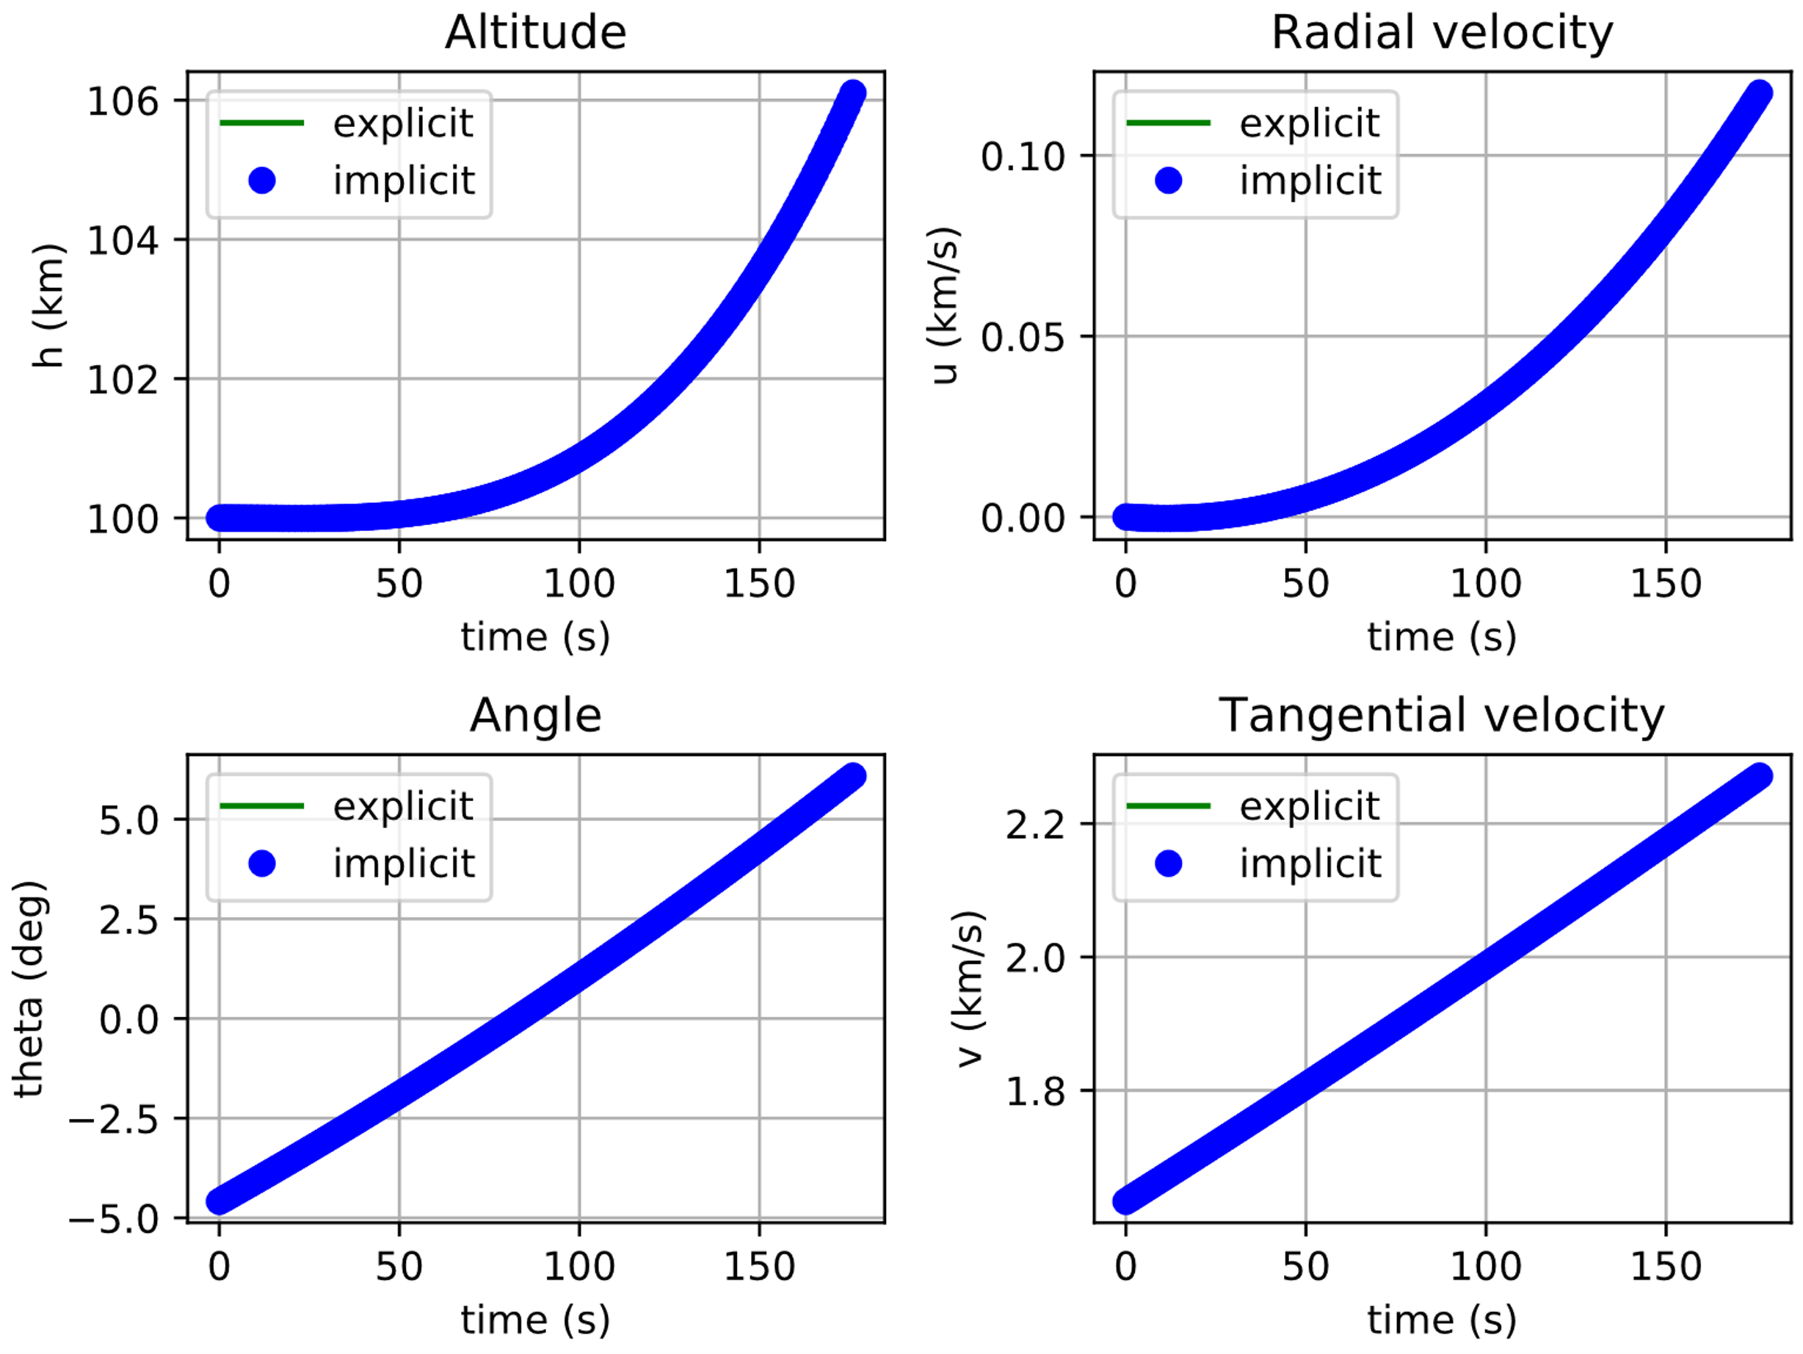
LLO to HEO: Finite Escape Burn
 | LLO | HEO
a | 1837.4 km | 34188.7 km
e | 0.0 | 0.9079
Isp | twr
450 s | 2.1
Time of Flight | Propellant consumption
3.1898 days | 13.97%
Notes:
Giuliana

Slide 16
Surrogate Models - Tools
Surrogate Modelling Toolbox⁹ (SMT)
Latin Hypercube, Full-Factorial
Kriging, Least-Squares, 2nd-order Polynomial
OpenMDAO MetaModel StructuredComp
Regular grid, provided
Polynomial splines, 1st to 5th order
Non-smooth derivatives
Smooth interpolation, direct integration in MDO
Sampling
Prediction
Results
Maximum Prediction Error
SMT | Kriging + LHS | 5.0e-4 | MMSC | Scipy_cubic | 1.0e-5
 | QP + FF | 13.e-2 |  | Scipy_quintic | 1.4e-6
⁹Bouhlel et al. “A Python Surrogate Modeling Framework with Derivatives.” Advances in Engineering Software (2019)
Notes:
Alberto

Slide 17
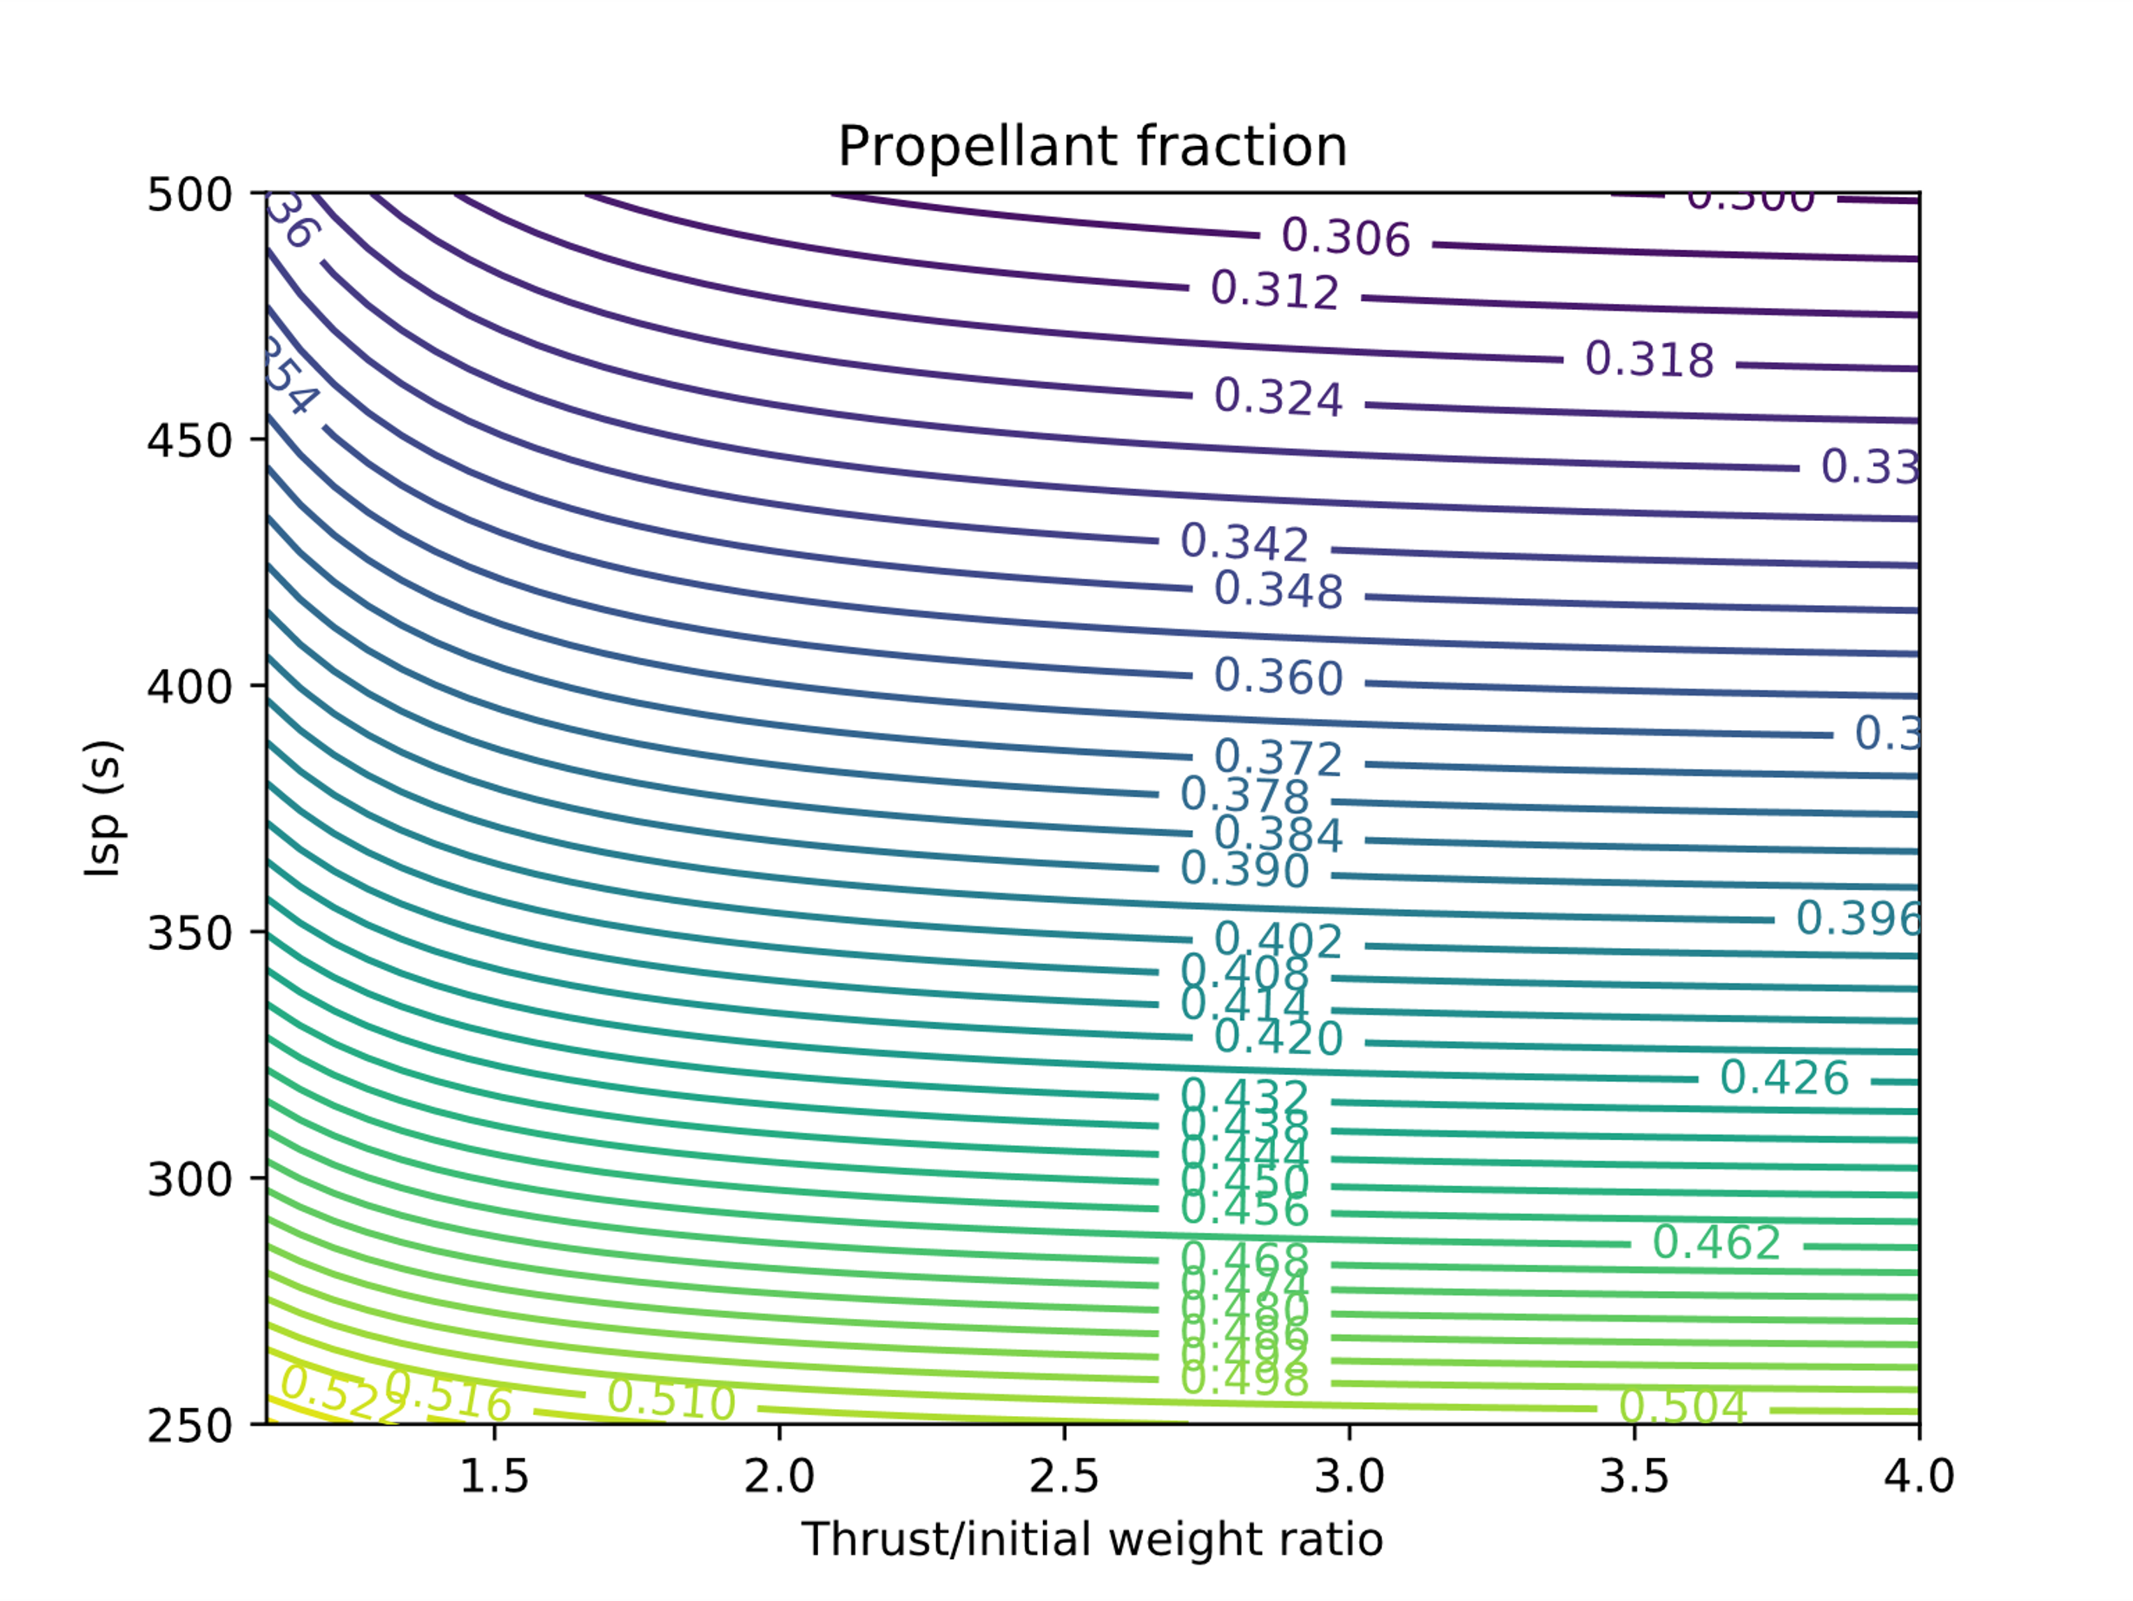
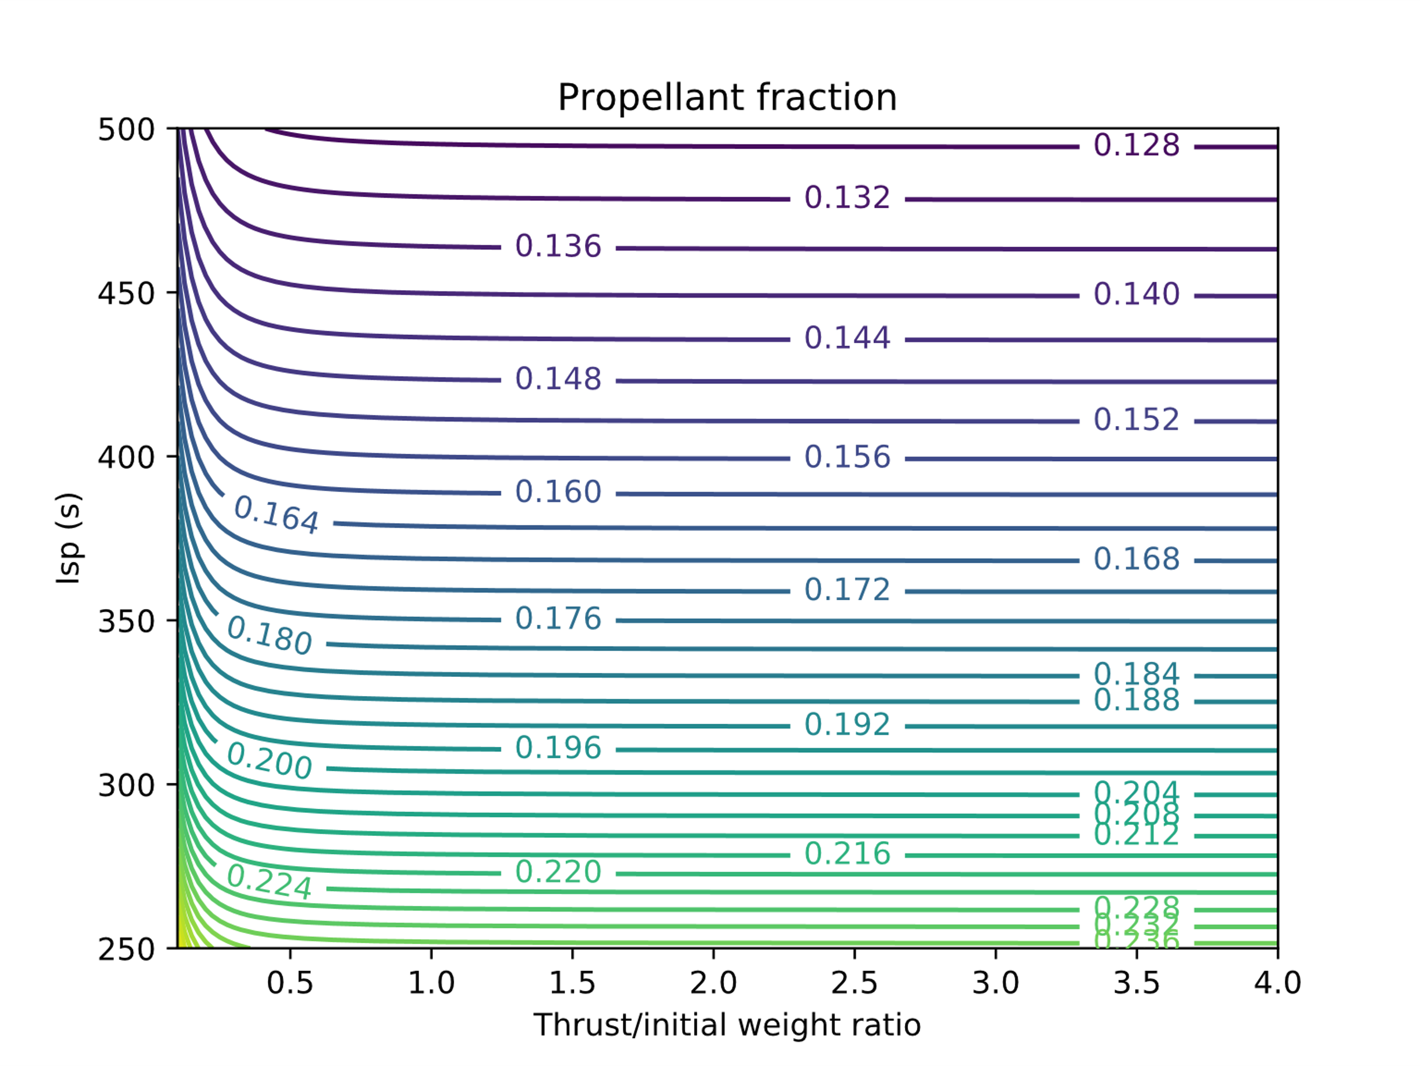
Surrogate Models - Examples
Descent trajectory with variable thrust
LLO to HEO transfer
Isp | twr
[250 s, 500 s] | [1.0, 4.0]
Isp | twr
[250 s, 500 s] | [0.1, 4.0]
Notes:
Alberto

Slide 18
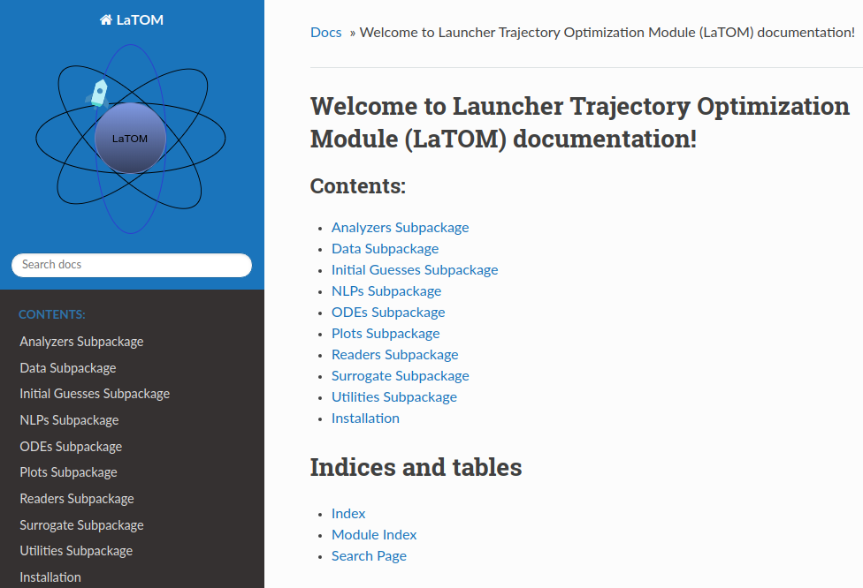
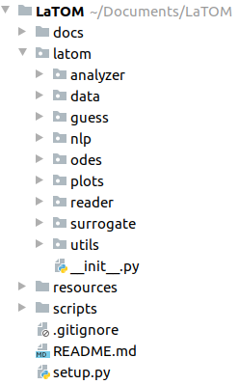
LaTOM Software Package
Launcher
Trajectory
Optimization
Module
Package documentation in HTML format
Package architecture
Notes:
Aberto

Slide 19
Conclusions & Future achievements
Current achievements:
2D ascent/descent Moon to LLO
2D ascent LLO to HEO
3D ascent Moon to LLO
Surrogate models for 2D cases
Future developments:
3D trajectories improvements
CR3BP for LLO to NRHO
High fidelity gravity model
Solar Radiation Pressure
Main issues:
CR3BP implementation
Selection for appropriate Surrogate Model library
Memory required for 3-phases LLO to HEO simulation
Simulations with very small twr values
Solutions:
Two-Body Problem approximation
Error comparison
Computations on Supercomputer
Continuation method
Notes:
Giuliana

Slide 20
Selected bibliography
Bouhlel, Mohamed Amine, et al. “A Python Surrogate Modeling Framework with Derivatives.” Advances in Engineering Software, July 2019, p. 102662. DOI.org (Crossref), doi:10.1016/j.advengsoft.2019.03.005.
Garg, Divya, et al. “Direct Trajectory Optimization and Costate Estimation of General Optimal Control Problems Using a Radau Pseudospectral Method.” AIAA Guidance, Navigation, and Control Conference, American Institute of Aeronautics and Astronautics, 2009, p. 29. American Institute of Aeronautics and Astronautics, doi:10.2514/6.2009-5989.
Gill, P., et al. “SNOPT: An SQP Algorithm for Large-Scale Constrained Optimization.” SIAM Review, vol. 47, no. 1, Jan. 2005, pp. 99–131. epubs.siam.org (Atypon), doi:10.1137/S0036144504446096.
Gray, Justin S., et al. “OpenMDAO: An Open-Source Framework for Multidisciplinary Design, Analysis, and Optimization.” Structural and Multidisciplinary Optimization, vol. 59, no. 4, Apr. 2019, pp. 1075–104. Springer Link, doi:10.1007/s00158-019-02211-z.
Hendricks, Eric S., et al. “Simultaneous Propulsion System and Trajectory Optimization.” 18th AIAA/ISSMO Multidisciplinary Analysis and Optimization Conference, American Institute of Aeronautics and Astronautics, 2017. American Institute of Aeronautics and Astronautics, doi:10.2514/6.2017-4435.
Herman, Albert L., and Bruce A. Conway. “Direct Optimization Using Collocation Based on High-Order Gauss-Lobatto Quadrature Rules.” Journal of Guidance, Control, and Dynamics, vol. 19, no. 3, May 1996, pp. 592–99. arc.aiaa.org (Atypon), doi:10.2514/3.21662.
HSL, A Collection of Fortran Codes for Large Scale Scientific Computation. http://www.hsl.rl.ac.uk/.
LaTOM 1.0 Documentation. https://mid2supaero.github.io/LaTOM/. Accessed 19 Mar. 2020.
Longuski, James M., et al. Optimal Control with Aerospace Applications. Springer-Verlag, 2014. www.springer.com, https://www.springer.com/fr/book/9781461489443.
Ma, Lin, et al. “Trajectory Optimization for Lunar Rover Performing Vertical Takeoff Vertical Landing Maneuvers in the Presence of Terrain.” Acta Astronautica, vol. 146, May 2018, pp. 289–99. ScienceDirect, doi:10.1016/j.actaastro.2018.03.013.
Perez, Ruben E., et al. “PyOpt: A Python-Based Object-Oriented Framework for Nonlinear Constrained Optimization.” Structural and Multidisciplinary Optimization, vol. 45, no. 1, Jan. 2012, pp. 101–18. Springer Link, doi:10.1007/s00158-011-0666-3.
Ramanan, R. V., and Madan Lal. “Analysis of Optimal Strategies for Soft Landing on the Moon from Lunar Parking Orbits.” Journal of Earth System Science, vol. 114, no. 6, Dec. 2005, pp. 807–13. Springer Link, doi:10.1007/BF02715967.
Shirazi, Abolfazl, et al. “Spacecraft Trajectory Optimization: A Review of Models, Objectives, Approaches and Solutions.” Progress in Aerospace Sciences, vol. 102, Oct. 2018, pp. 76–98. ScienceDirect, doi:10.1016/j.paerosci.2018.07.007.
SMT: Surrogate Modelling Toolbox - SMT 0.4.2. https://smt.readthedocs.io/en/latest/. Accessed 18 Mar. 2020.
Topputo, F., and C. Zhang. “Survey of Direct Transcription for Low-Thrust Space Trajectory Optimization with Applications.” Abstract and Applied Analysis, 2014, doi:10.1155/2014/851720.
Wächter, Andreas, and Lorenz T. Biegler. “On the Implementation of an Interior-Point Filter Line-Search Algorithm for Large-Scale Nonlinear Programming.” Mathematical Programming, vol. 106, no. 1, Mar. 2006, pp. 25–57. doi:10.1007/s10107-004-0559-y.

Slide 21
Thank you for your attention

